Slide 1











Seaport Antwerp, mobility partner
for Slovakia
Professional Conference ZLZ SR 2018
Walter Holzhammer

Slide 2

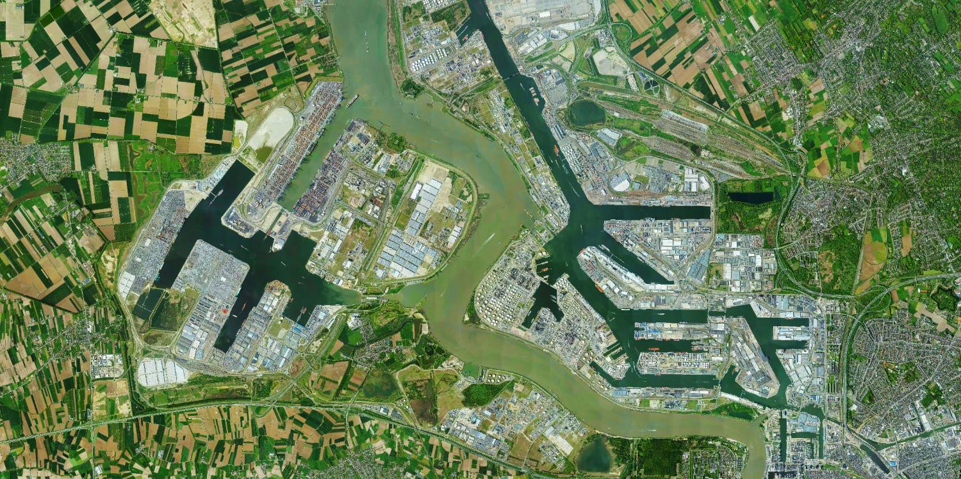





Latest developments in Antwerp
223
Containers
Liquid bulk
Breakbulk
Dry bulk
million tons
of freight
123
73
15
12
Mln tons
Mln tons
Mln tons
Mln tons
Notes:
In 2017, for the first time in its history, Antwerp Port handled almost 223 million tonnes of goods and over 10 million standard containers. Growth continued this year as well. During the first semester, the port knew an increase of 6,5% in total cargo handling. The main driver continues to be container freight which experienced further rapid growth of 8.2%.
Antwerp has more port area than any of its competitors. The container capacity is 15 million TEU. According to current growth forecasts, it will soon be fully utilised. We are therefore investigating which location in the Port of Antwerp is best suited to create additional capacity for container traffic. Our preference is for a second container dock on the left bank. This is in front of the locks because it best meets the needs of the market there. The Antwerp Port Authority intends to invest in these additional capacities in order to secure employment and to open up new opportunities for the 900 private companies operating in the port area.
In addition, I would also like to point out that the balance between incoming and outgoing goods flows in Antwerp is balanced. This contributes to good KPIs for our supply chains to and from North Rhine-Westphalia, e.g. in terms of reliability, quality, sustainability, flexibility, total costs and lead times.

Slide 3
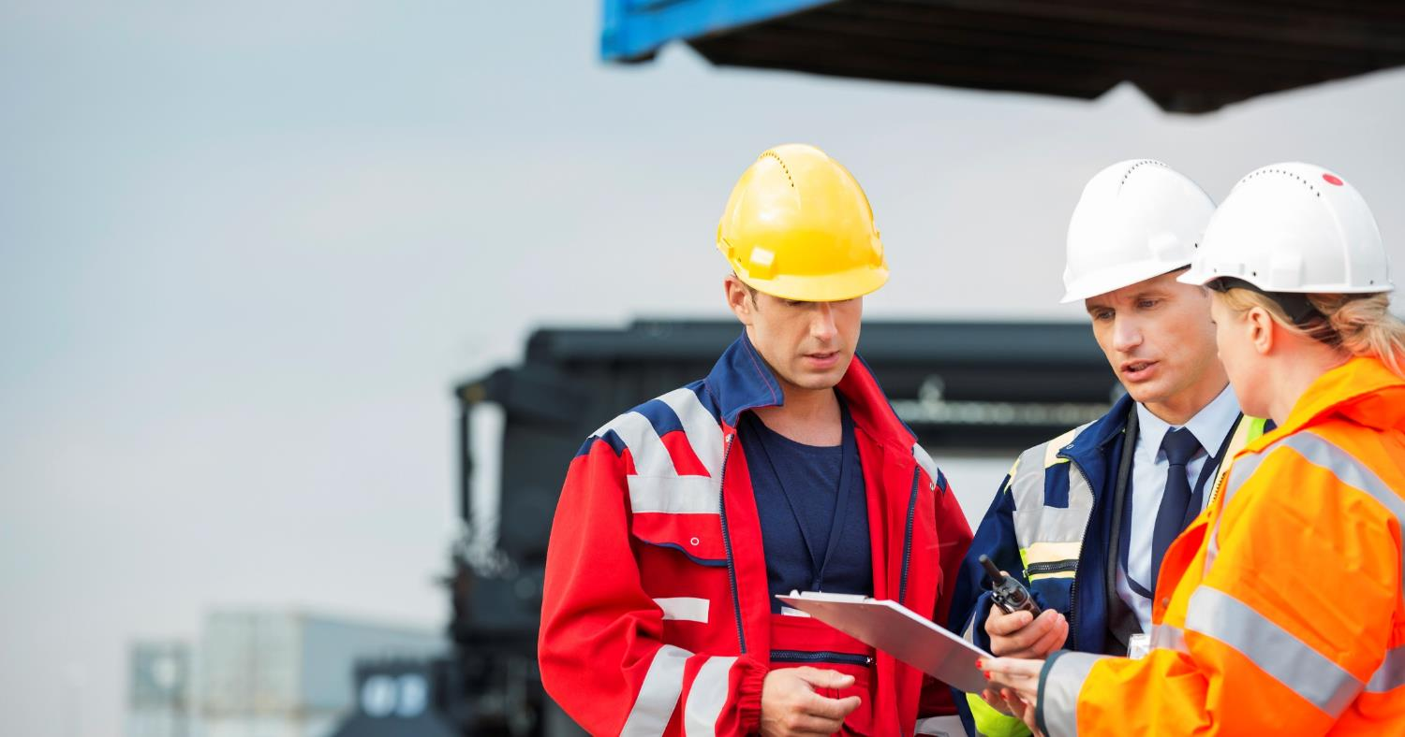
Growing in a sustainable way
Notes:
last years development of the Port - 5 consecutive Years with increased Turnover. First Half of 2018 - again a record in numbers: …
-----------------------------------------------------------------------------------------------------------------------------------------
Strong growth figures in the last decade
Containers and liquid bulk are the growth drivers in Antwerp.

Slide 4





Strategic priorities set by the Antwerp Port Authority
Sustainable growth
Mobility
Transition
Safety and Security
Operational efficiency
Notes:
New business plan 2018-2020 with strategic priorities which should anchor the competitive position of the port Antwerp in the coming years. (SLIDE) We focus on:
Sustainable growth:
Managing and developing sites and infrastructure remains one of our core tasks.
Combination of inland location and spare capacity (Saeftighe development area) is great asset for our hinterland customers
Mobility:
The port must at all times remain accessible for goods and people. Only a far-reaching modal shift will be able to offer a sustainable solution.
Great efforts have been taken to optimize cargo transport in the port. (refer to barge action plan and rail optimization)
Transition:
innovative concepts as circular low-carbon economy and digital transition in the port platform
refer to Supernova: SuperNova offers a two-day conference featuring today’s game changers - where thought leaders share their visions and insights on the technology, business concepts and creative ventures of tomorrow. (SLIDE)
(Safety & security and operational excellence are the two remaining strategic priorities)

Slide 5

Enabler for energy transition
CO₂ roadmap
CCS / CCU
LNG bunkering
Power-to-methanol
Onshore power supply
Transition fund
Notes:
(Austria is very active in sustainable energy such as water power stations)
Efforts of the port Authority to enable the transition towards sustainable enrgery
- CO2 roadmap 2020-2050 is being designed for the port area – together with all stakeholders in logistics, maritime and industrial sectors
- CCS: Carbon capture storage: research for building a backbone / pipeline towards the Northsea where carbon will be stored and used (CCU:
Carbon capture utilation)
- LNG Bunkering: facilitate and encourage the use of LNG (Liquefied Natural Gas) as a shipping fuel
- Power to methanol: innovatory method to produce fuel from renewable energy
- Onshore power supply: construction of terminal by 2020 to supply seagoing vessels with power from the key
- Transition fund: Financial ressources to build infrastructure or support companies in their sustainable energy efforts.

Slide 6
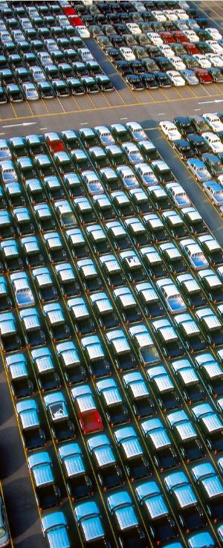
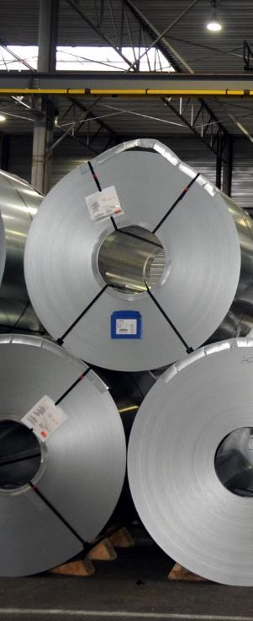



Multifunctional port
Open for all types of goods
Notes:
As a multifunctional port, Antwerp is open to all kinds of goods. In the picture illustrated by vehicles, fruit, coffee, steel and polymers.
Goods from all over the world are handled, stored, processed and refined in our port on a daily basis. Temperature-controlled cargo such as fruit has experienced particularly strong growth in recent years.
European leader in steel, coffee (world trade), fruit (bananas), …
Growth container in all commodities – example fruit
Coffee – certified for stock markets of London (LIFFE Robusta) and NY (NYBOT) Arabica.
Fully approved and accredited by world’s leading exchange for soft commodities – ICE and NYSE
London Metal Exchange – accredited warehouses.
Specialised and certified storage facilities for hazardous goods.

Slide 7
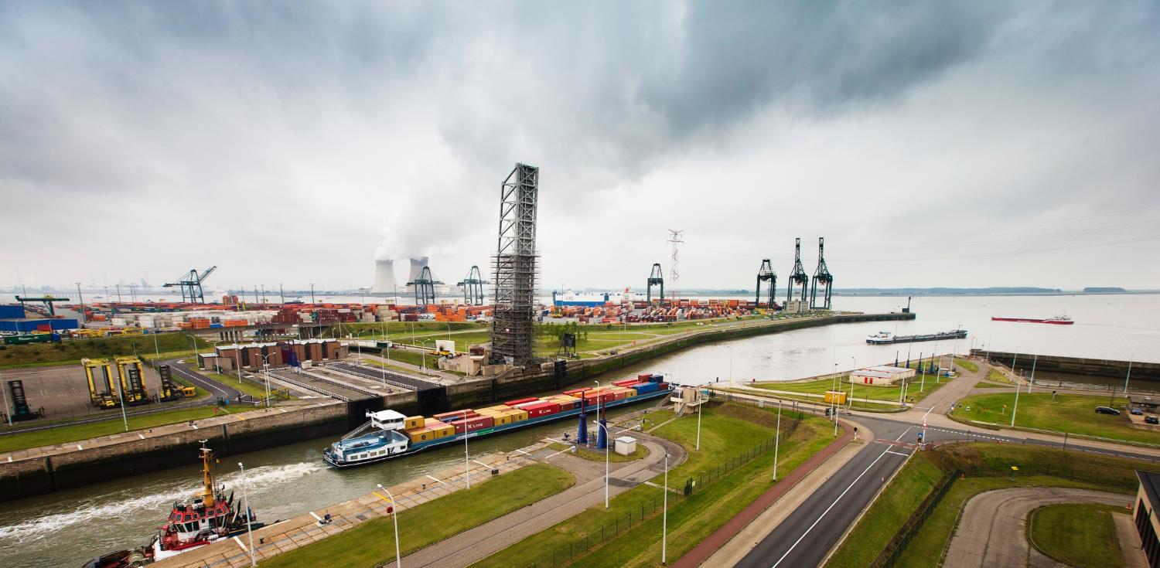

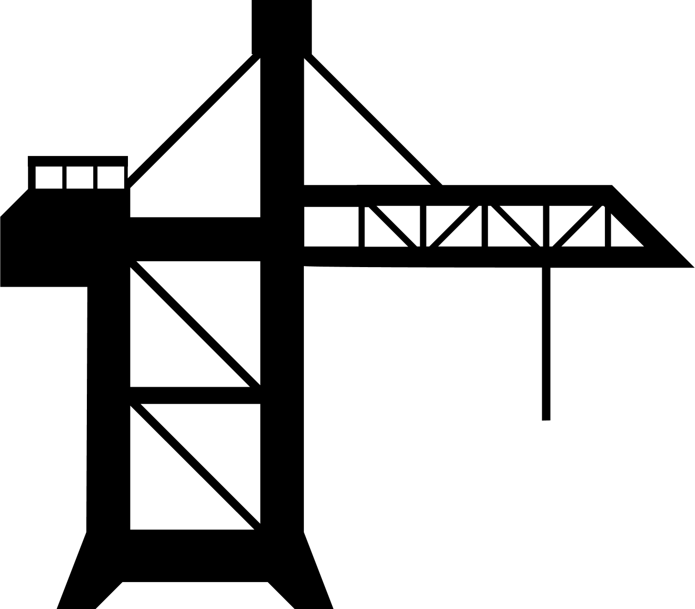

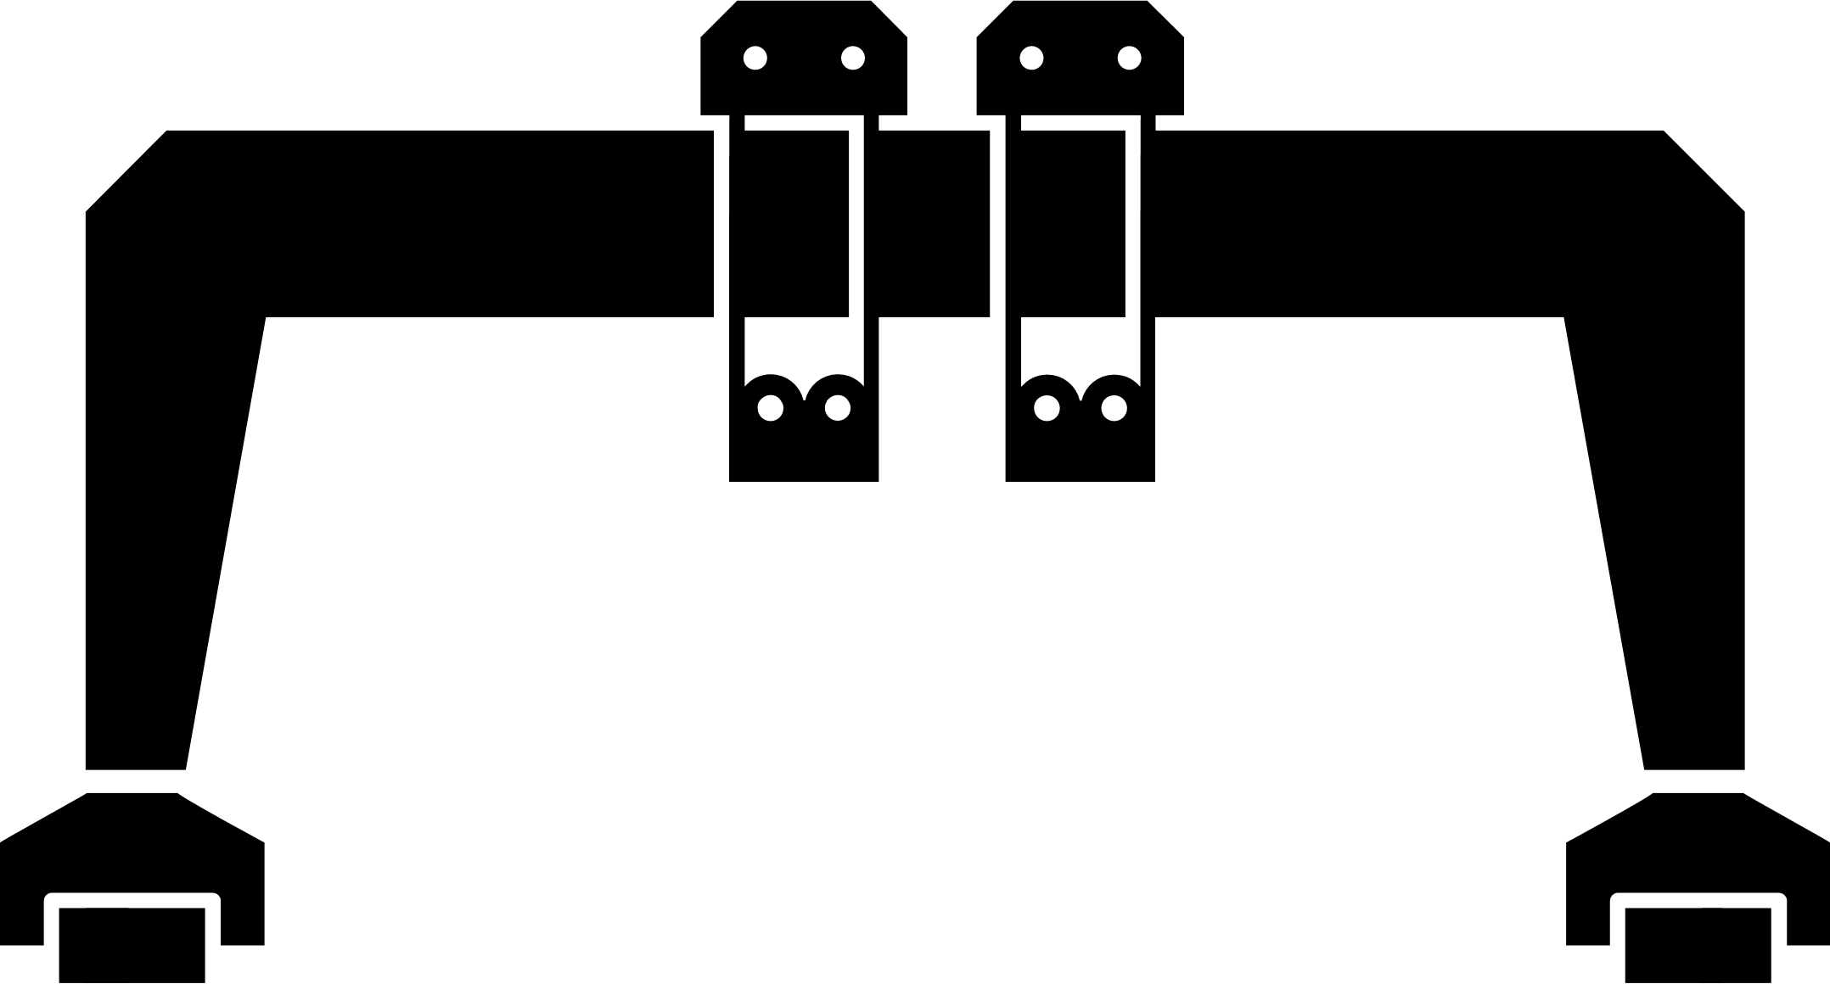












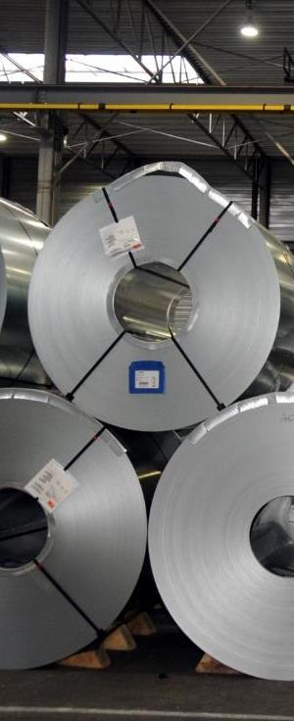
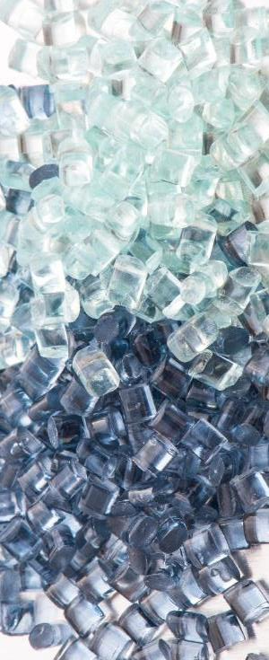

16 terminals
liquid bulk
5 deepsea terminals
container
15 terminals
breakbulk
12 terminals
dry bulk
7.2 million m³
tank storage
6.3 million m²
covered storage
680.000 m³
Silo storage polymers
Notes:
DL
Das Angebot an spezialisierten Terminals, Lägern und Umschlagsmöglichkeiten macht Antwerpen zu einem Welthafen.
16 unabhängige Tanklagerterminals für liquid bulk mit der größten Konzentration von Edelstahl-Tanks weltweit,
5 deepsea-Containerterminals,
12 spezialisierte drybulk-Terminals,
15 Breakbulk-Terminals mit State-of-the-Art Handling & Hebezeugen,
darunter das Allweather-Terminal von Wijngaard Natie, in dem selbst bei Starkregen Stahlladungen ohne Unterbrechung geladen und gelöscht werden können.
DD
Damit Sie bei dem reichen Angebot der Dienstleister den Überblick behalten, hat die Antwerp Port Authority auf ihrer Webseite ein digitales Unternehmensverzeichnis gestartet, das Ihnen die Suche nach Logistikdienstleistern im Antwerpener Hafen kollossal erleichtert. Im Fokus stehen Terminals, Lagerhallen und Leercontainer-Depots.

Slide 8
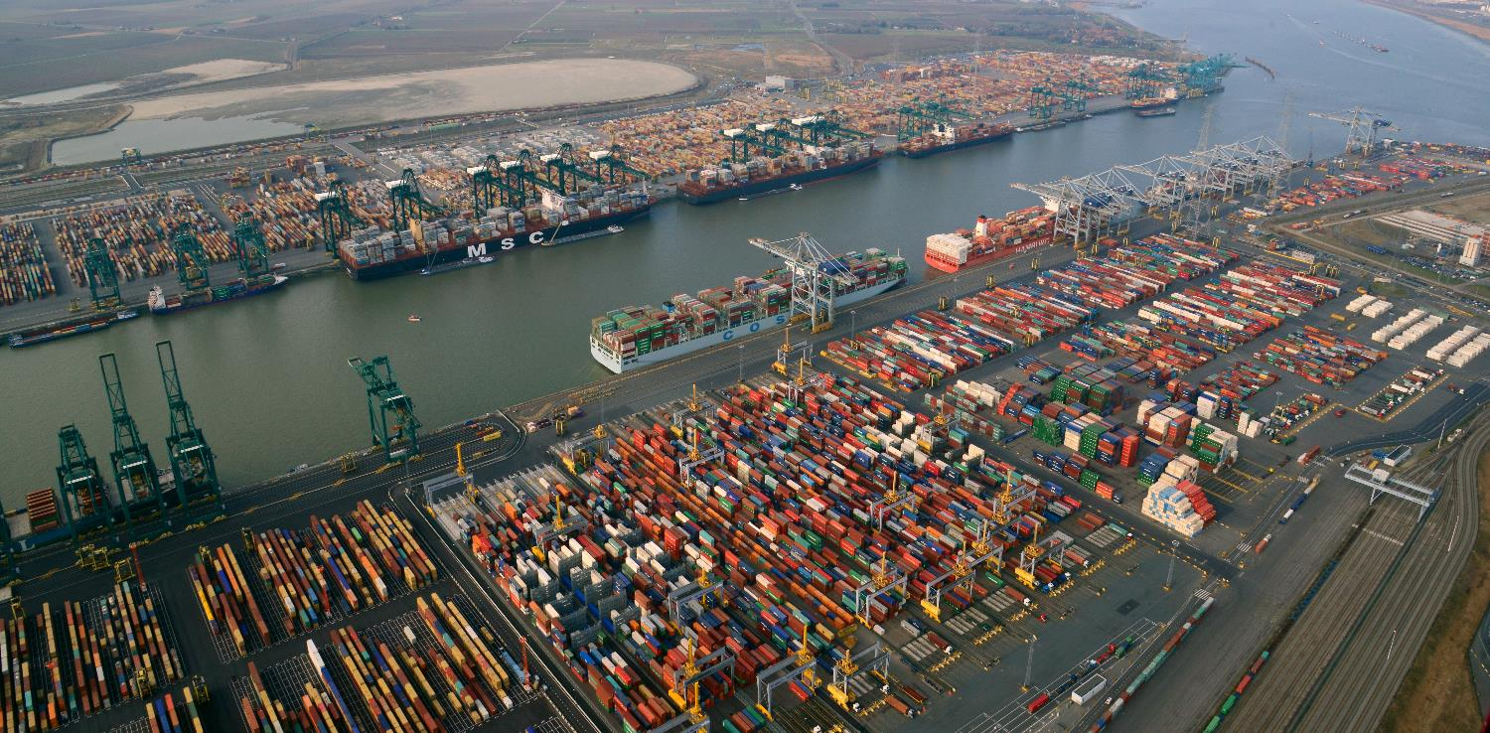
Container Giant
Extended capacity at deep sea container terminals
Notes:
- PoA clearly can follow the dynamic development of the growing Vessel Sizes
- PoA can handle the biggest vessels, Vessels can arrive full and leave full.
- Carriers can work with scale effects to run their Vessels profitable and focusing their interests in Antwerp - why doing 4 Ports in Europe and not 2? - Cargo and Logistics will follow
- Highly efficient Container Terminals
In the last 10 years, the total transhipment volume in Antwerp has increased by almost 50 million tonnes, with significant gains in the share of containerised goods.The Antwerp deep-sea container terminals have had to reposition themselves in order to be able to handle more and more goods in containers and, with growing ship sizes - keyword: mega-carrier. Although they still achieve the highest productivity in Europe with up to 43 movements per crane and hour. Last year, MSC's Antwerp home terminal moved completely from the Delwaide Dok on the right bank to the Deurganck Dock on the left bank. The new MSC PSA European Terminal MPET now has 41 container gantry cranes available, up to 130 m high and with a reach of up to 25 container widths.
DP World, the second major player in container handling, also invested heavily. In automatic stacking cranes, gantry cranes and straddle carriers. DP World has also expanded its capacities in Deurganck Dok by adding a special inland waterway terminal and additional storage space. The Deurganck Dok, which is directly accessible from the Scheldt, has thus become the largest container handling basin in Europe, with a capacity of 9 million TEU. On the former MSC terminal, ICL/IMT now operates as a niche carrier for container traffic with the US East Coast.

Slide 9
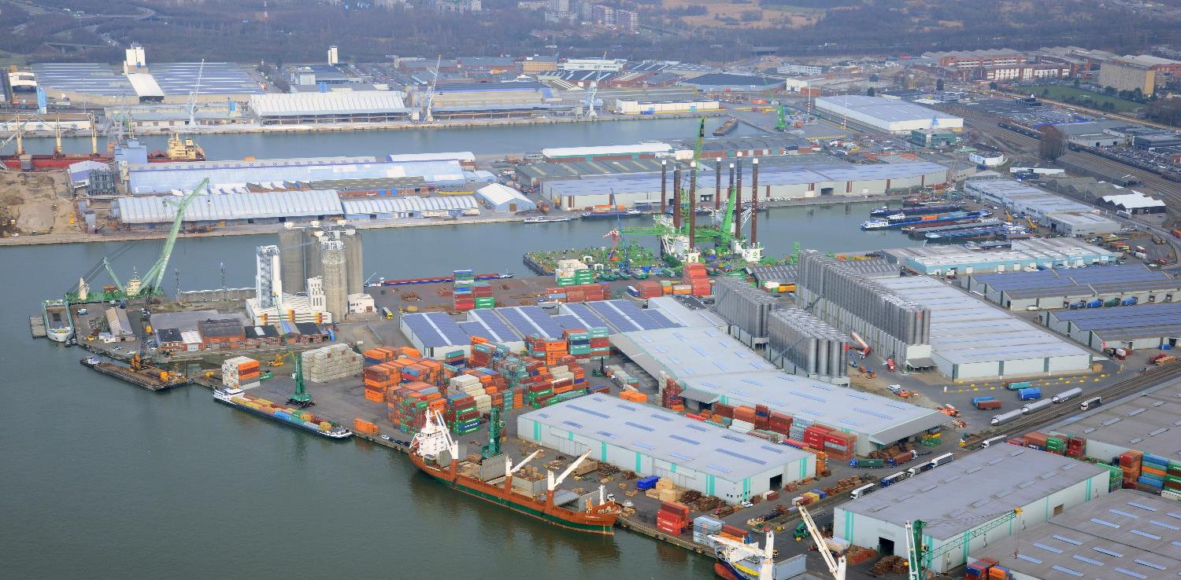
Longstanding expertise at multipurpose terminals
Your steel, machinery, paper and cars are in good hands
Notes:
Refer to 17 breakbulk terminals in Antwerp (some of them are present) and the longstanding expertise for handling Autrian steel, paper and machinery!
Hungarian cars and spare parts!
+ VAL
Antwerp remains the European home port for Breakbulk. Because of the good equipment of the terminals, their great expertise and care by the Antwerp labour force, terminal operators and logistics companies. I am thinking, for example, of the steel service centres with their processing and cutting of steel, the vehicle processing centres with their customization and repair of vehicles or the terminals with numerous services for fruit, wood and project cargo.
You might give the example of the paper export with rail & sea via Zuidnatie?
Background:
Conventional breakbulk got off to a good start at the beginning of the year but then declined as a consequence of lower imports of iron and steel..
The drop in iron and steel imports in the first six months of 2018 is mainly due to the anti-dumping measures imposed on Chinese steel by the EU. Imports of steel from India too were well below the level of the same period last year.
Steel exports on the other hand present an opposite picture, with growth of 7%. There was a strong upsurge in steel exports to the US in an effort to beat the American import tariffs which came into force in June.
However it is expected that these tariffs will also have an indirect negative effect on imports of iron and steel. Given the expected dumping of steel from all over the world on the European market as a consequence of the American tariff measures, the EU itself will probably be obliged to take measures to protect its own markets.

Slide 10
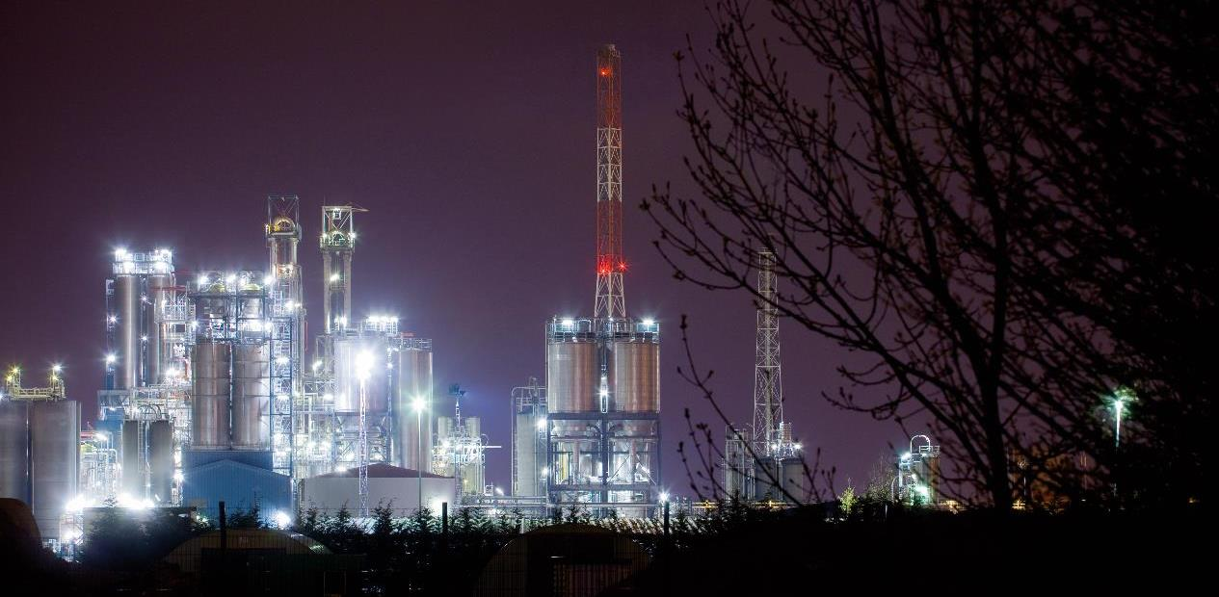
European largest oil & chemical cluster
Major investments in chemistry
Notes:
Antwerp = Europe’s largest integrated petrochemical cluster
All top international players have production plants in Antwerp (Total, ExxonMobil, BASF, Lanxess, …)
Its production facilities are connected by an intra-pipeline network of 1,000 km. As a result, more than 60% of the liquid bulk volumes are transported for industry and tank farms in Antwerp. The network consists of more than 48 different product pipelines and is connected to the European pipelines network.
Key: safety & sustainability
Together with the logistics know-how and highly productive handling facilities, the massive industrial presence in the port area is the triple advantage of the Antwerp port. I mean the presence of the largest integrated petrochemical cluster in Europe.
All international top players in the petrochemical industry are represented in Antwerp.
Their production facilities are connected by an intra-pipeline network of 1,000 km.
The network consists of more than 48 different product pipelines and is connected to the European pipeline network.
Let’s have a look at the following movie.

Slide 11

A port with a unique location
Reliable hub for intercontinental trade
Notes:
Antwerp as a global player in global logistics
Worldwide network
Top 5 main trade partners of the Port of Antwerp (total volumes)
1) USA
2) Rusland
3) UK
4) China
5) Turkije
Strong on export position but developing strongly on import loops:
Give some examples (cfr mail DP World, Michiel V.)
A high-frequency and dense network of maritime transport links is crucial for a seaport.
Today Antwerp offers direct maritime connections to 1,300 ports worldwide.
All major container shipping companies with European services call at our port on a weekly basis. And Antwerp, the European market leader in container traffic with the Middle East, North and Latin America, India and Africa, ranks 14th among the TOP 20 container ports from all over the world.

Slide 12
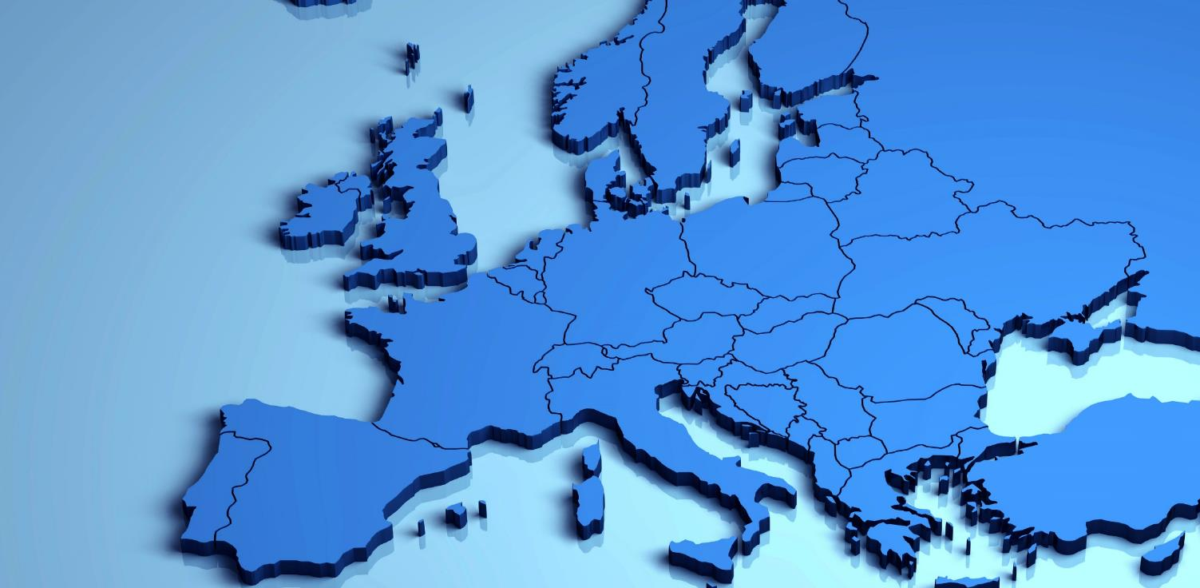
Extended intermodal offer to/from hinterland
Modal Split Target 2030
40 – 40 – 20
Notes:
- Regular and well-developed waterway and rail connections in hinterland traffic: to 70 destinations in 19 European countries
- High-frequency connections with Germany, France, the Netherlands, Switzerland, Austria and Italy.
In order to optimize mobility in our port, the modal shift in favour of rail transport and inland navigation is the highest priority of our port.

Slide 13
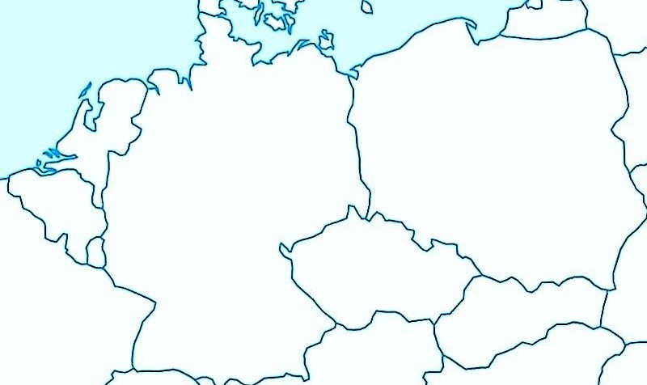
Importance of Slovakia for the Port of Antwerp
LOVOSICE/ÚSTÍ n. LABEM DIRECT 3 trains per week
PASKOV – LOVOSICE 5 trains per week
BRATISLAVA DIRECT 3 trains per week
DUISBURG DIRECT 5 trains per week
PRAHA – DUISBURG 3 trains per week
PŘEROV – LOVOSICE 5 trains per week
D.STREDA – PRAHA 3 trains per week
LOVOSICE – DUISBURG 5 trains per week
BRNO – LOVOSICE 5 trains per week
HANISKA – LOVOSICE 3 trains per week
Duisburg
Antwerp
Lovosice
Praha
Ostrava-Paskov
Přerov
Brno
Haniska
Bratislava
Dunajská Streda

Slide 14
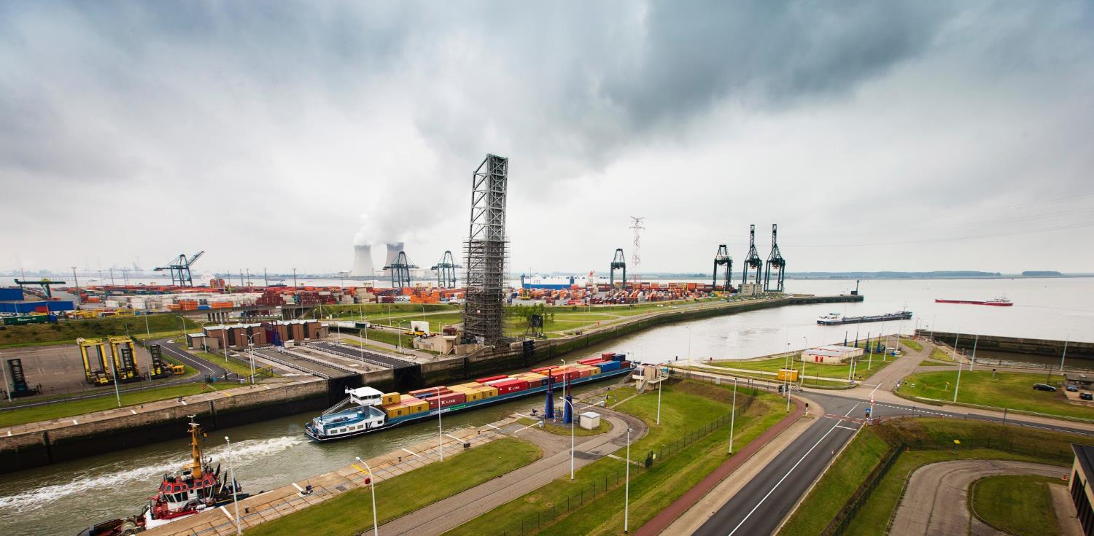
Setting conditions for efficient intermodal transport
INTERMODAL SOLUTIONS
Consolidation hubs
Modal shift
EFFICIENCY
Last mile initiatives Collaboration
Action plan night-time logistics
INFRASTRUCTURE
Investments in port area
Innovative concepts
Notes:
It is important to us that the port is accessible, accessible and that the last mile can run as efficiently as possible. Our strategy in this respect is based on: Infrastructure, efficiency and Intermodal Solutions projects (e.g. network moments to modal shift).
Es ist uns wichtig dass der Hafen zugänglich, erreichbar ist und die letzte Meile wie effizient möglich verlaufen kann. Unsere Strategie in diesem Hinsicht basiert auf: Infrastruktur, Effizienz und Intermodal Solutions Projekten (u.a. Netzwerkmomenten zum Modalshift).

Slide 15
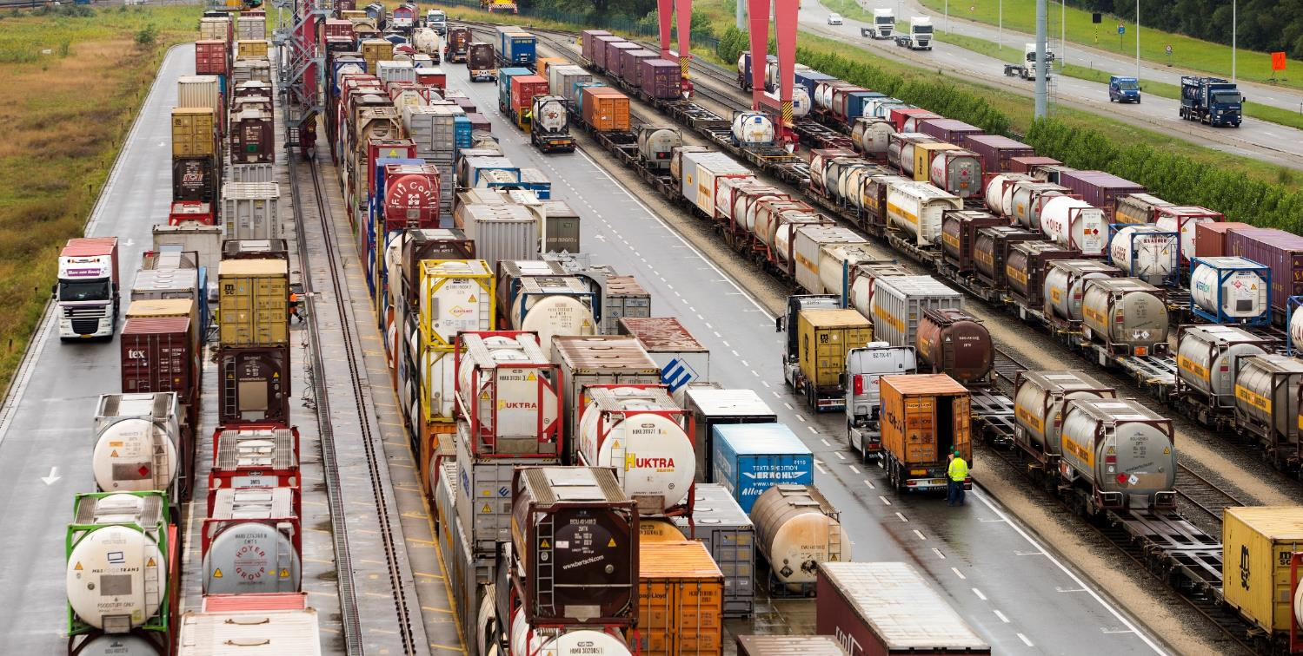
Tangible rail initiatives
RAILPORT
Infrastructure capacity management
Rail Traffic System ICT platform
Financial support new shuttles consolidation
Commercial actions hinterland
Notes:
For the Port of Antwerp, shifting transport to rail is a top priority. The aim is to double rail transport.
For this purpose we have established the company Railport: Railport's main task is to coordinate the various railway activities in the port of Antwerp and to act as a link between the railway companies, the railway infrastructure manager, the port companies and the terminals.
Railport is working together with the Belgian infrastructure company Infrabel. Together with them, we want to develop a new operating model for the rail infrastructure in the port to make rail transport and the last mile in Antwerp more flexible and efficient. We are also working intensively on a new digital platform that will enable transparent communication between railway companies and container terminals in the port, thus improving planning and transit times in the port.
Together with the Flemish government, we will start a new support programme in autumn, which will also financially support the start-up phase of a new train connection and the consolidation in the port.

Slide 16
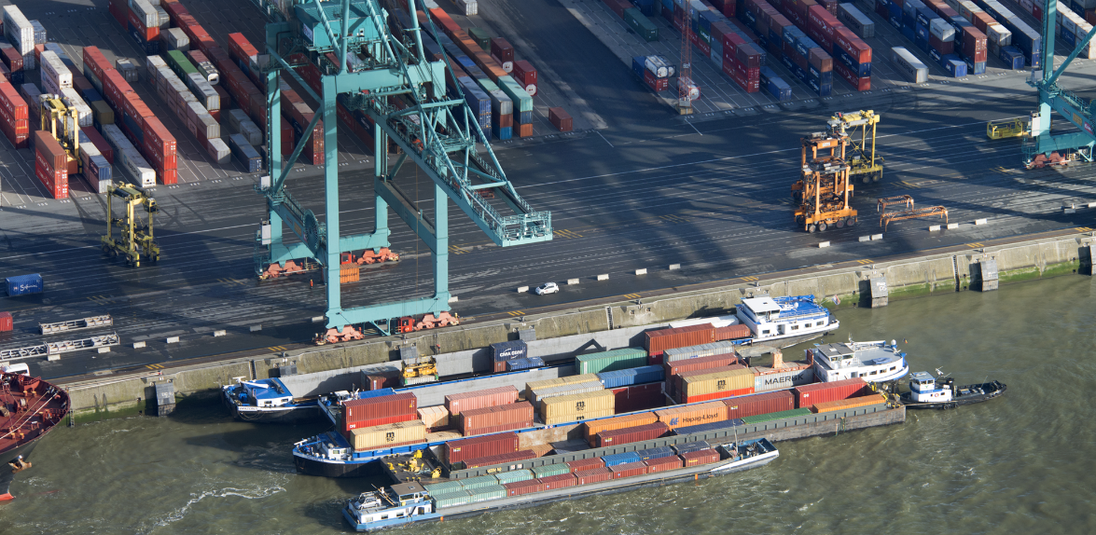




Action plan for barge optimisation in the port
Collaboration & Planning
Resources
Consolidation
Digitalisation
Notes:
- perfect connection via Rhein/Main/Danube Canal
Innovative projects to raise the efficiency of inland navigation & promote the use of this mode
In close cooperation with the different stakeholders
Decrease losses & increase capacity for container barges
Raise reliability of the planning
Increase efficiency for all stakeholders
Mid 2017 up to now:
July 2017: A declaration of intent signed by different representatives e.g. shippers, shipping lines, terminals, barge operators
October 2017: 4 working groups in action
17 april 2018: handshake ‘action plan inland navigation’ and preparing implementation
WHY? to make the handling process and throughput of container barges faster and more reliable in the port of Antwerp
HOW? a set of initiatives aimed at making structural improvements to the process such as communication, dedicated berths, consolidation of small volumes etc.
Container barge transport
In Summer, all stakeholders involved in the port of Antwerp signed a roadmap of structural measures to make container barge transport more efficient and further develop it. Concrete initiatives have been defined for this purpose and drawn up in an implementation plan. With this agreement the parties have not only confirmed their previous commitments but have also worked out structural and feasible solutions to permit sustainable growth of container barge transport and of the port of Antwerp itself.
Background: rapidly growing freight volumes + larger sizes of seagoing ships calling at the port led to peak load on the terminals, with longer waiting times for container barges as a result.
Shipping terminals, barge operators, shipping companies, shippers, forwarders, NxtPort, CEPA, the Flemish Government, Flemish Waterways, Alfaport-Voka and Antwerp Port Authority have supported and committed to a concrete plan of action. The agreements concentrate on 3 main areas:
1. Planning & collaboration (more structured, transparent planning process resulting in greater reliability for barge handling)
2. Consolidation of freight volumes will make it possible to have larger call sizes for the barges handled on the terminals; this is important to make the growth of the port more sustainable. As of October (trial period), the minimum call size has been set at 30 containers per call. The Flemish government and Antwerp Port Authority have introduced a temporary package of operational and financial subsidies which will gradually taper off.
3. Digitisation. Focus on sharing of info, NxPort initiatives. Elmar
The combination of all these measures should result in the desired gains in efficiency for all partners in the supply chain.
Auf Deutsch
Das Ziel ist die Effizienzsteigerung und die Erniedrigung der Wartezeiten in dem Hafen. Zu diesem Zweck hat die Antwerpener Hafengemeinschaft den Aktionsplan Containerbinnenschifffahrt unterzeichnet, der die Effizienzsteigerung bei allen Parteien in der Lieferkette auf eine nachhaltige Weise fördern soll. Die Vereinbarungen beziehen sich konkret auf vier große Säulen: Planung, Zusammenarbeit, Bündelung, Digitalisierung. Pilotprojekte zur Frachtbündelung an Konsolidierungshubs im Hinterland und im Hafen werden in diesem Herbst starten und werden dazu beitragen dass man mit einem ‘mimum call size‘ von 30 Containers auf einem Schiff effizienter transportieren kann. Die zentrale Planung (PSA Terminal) wird seit diesem Herbst dafür sorgen die Planung zwischen den Operateuren besser abgestimmt wird und die Wartezeiten eliminiert werden.

Slide 17

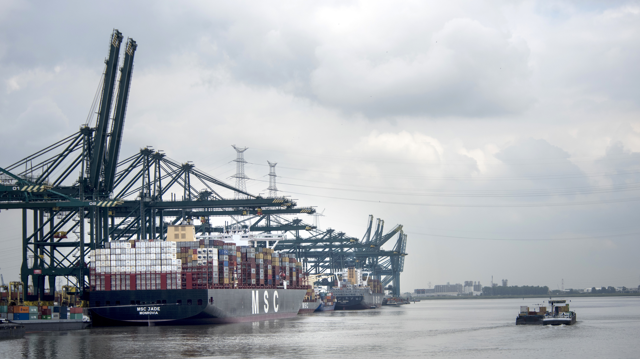
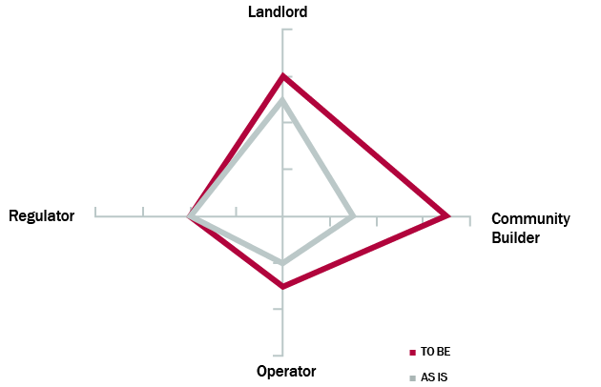
Welcome to the VUCA World
Volatility
Uncertainty
Complexity
Ambiguity

Slide 18


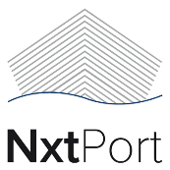
Driving digital business
Digitilization in the port
Collaboration
Notes:
Digitization / Smart Port of the Future / Our role in creating the history of Logistics / Nxtport
---------------------------------------------------------------------------------------------------------------------
Goal: a smooth logistic flow - ensuring a safe and secure port => reliability & predictability are top priority PoA + transparency for customers
This digital change is happening today, but does not come automatically nor without hick-ups. In order to realize full digital flows, you need real collaboration between all stakeholders of the supply chain. Without collaboration, the supply chain process will be fragmented with an associated fragmented dataflow.
Therefore, in Antwerp, the port community took the initiative to set up NxtPort, a data platform for exchanging operationally important data in the supply chain. Different partners are encouraged to trust their data anonymously to the platform and with these data, developers are to build targeted supply chain solutions covering all transport modes and supply chain processes.
The beauty of data platforms like Nxtport is the fact that the more companies share data, the more valuable the platform becomes for everyone. Call it a perfect example of a win-win approach ! You will understand that collaboration is crucial.
The Antwerp Port Authority is committed to be an active partner. We participate in the working capital of NxtPort, and will use this platform to share data with the community and to connect our port community applications. Our participation is a strong signal of our commitment to facilitate the efficiency of supply chains.

Slide 19
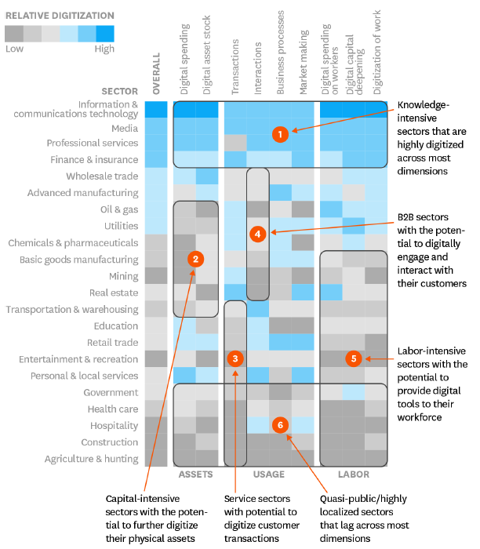
Harvard Business review: which sectors are the most digital and why ? - 2016

Slide 20

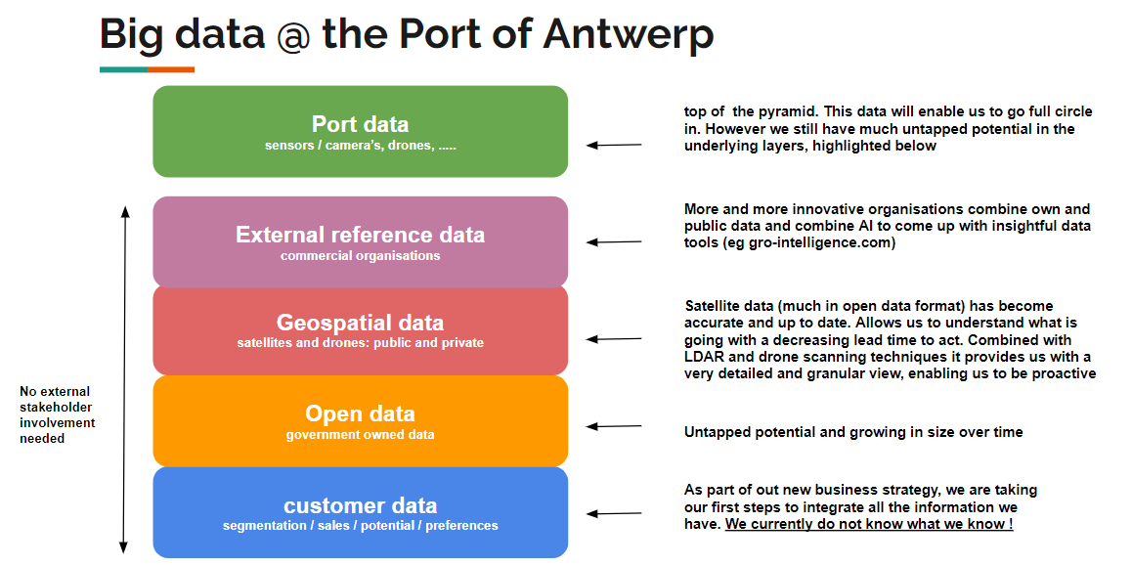

Slide 21
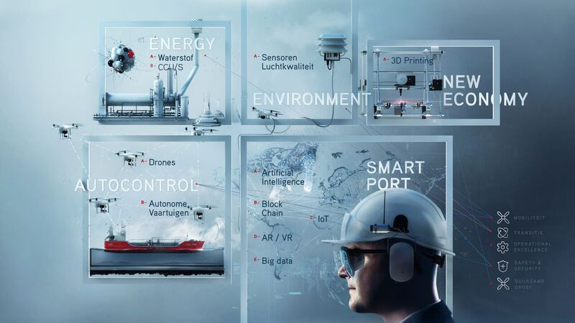

Slide 22
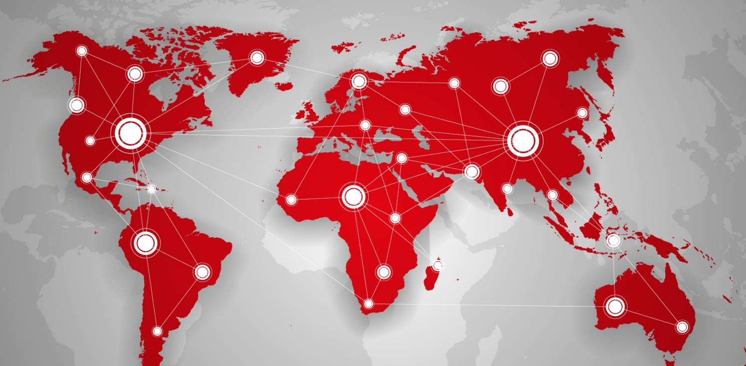





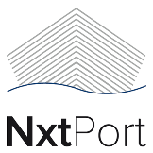



Global Data Platforms
Notes:
Technology : from barrier to enabler
Mental renaissance for collaboration / Mental shift towards maturity of the mind
Business requirements in the globalized world: A digital core is needed
Market forces have increased the need for efficiency and cost reduction: need for speed
Connecting different partners in the supply chain physically is a first step, but it should go hand in hand with digital flows to fulfil the obligatory administration easily and create transparency in every phase of the logistical flow. Copying data manually from one system into another should be history soon. Intelligent digital networks should support our daily business and make it more flexible.
The existing uncertainty on the world markets, driven by economic and political challenges, creates an unprecedented Volatile, Uncertain, Complex and Ambiguous world. At the same time, digitalisation is disrupting business models. This cocktail of reinforcing dynamics is challenging us as Port Authority as well. What will our future role be ? Will it be the same or something totally different ? We believe that part of the answer lies in our ongoing ability to connect, to collaborate and to innovate.

Slide 23
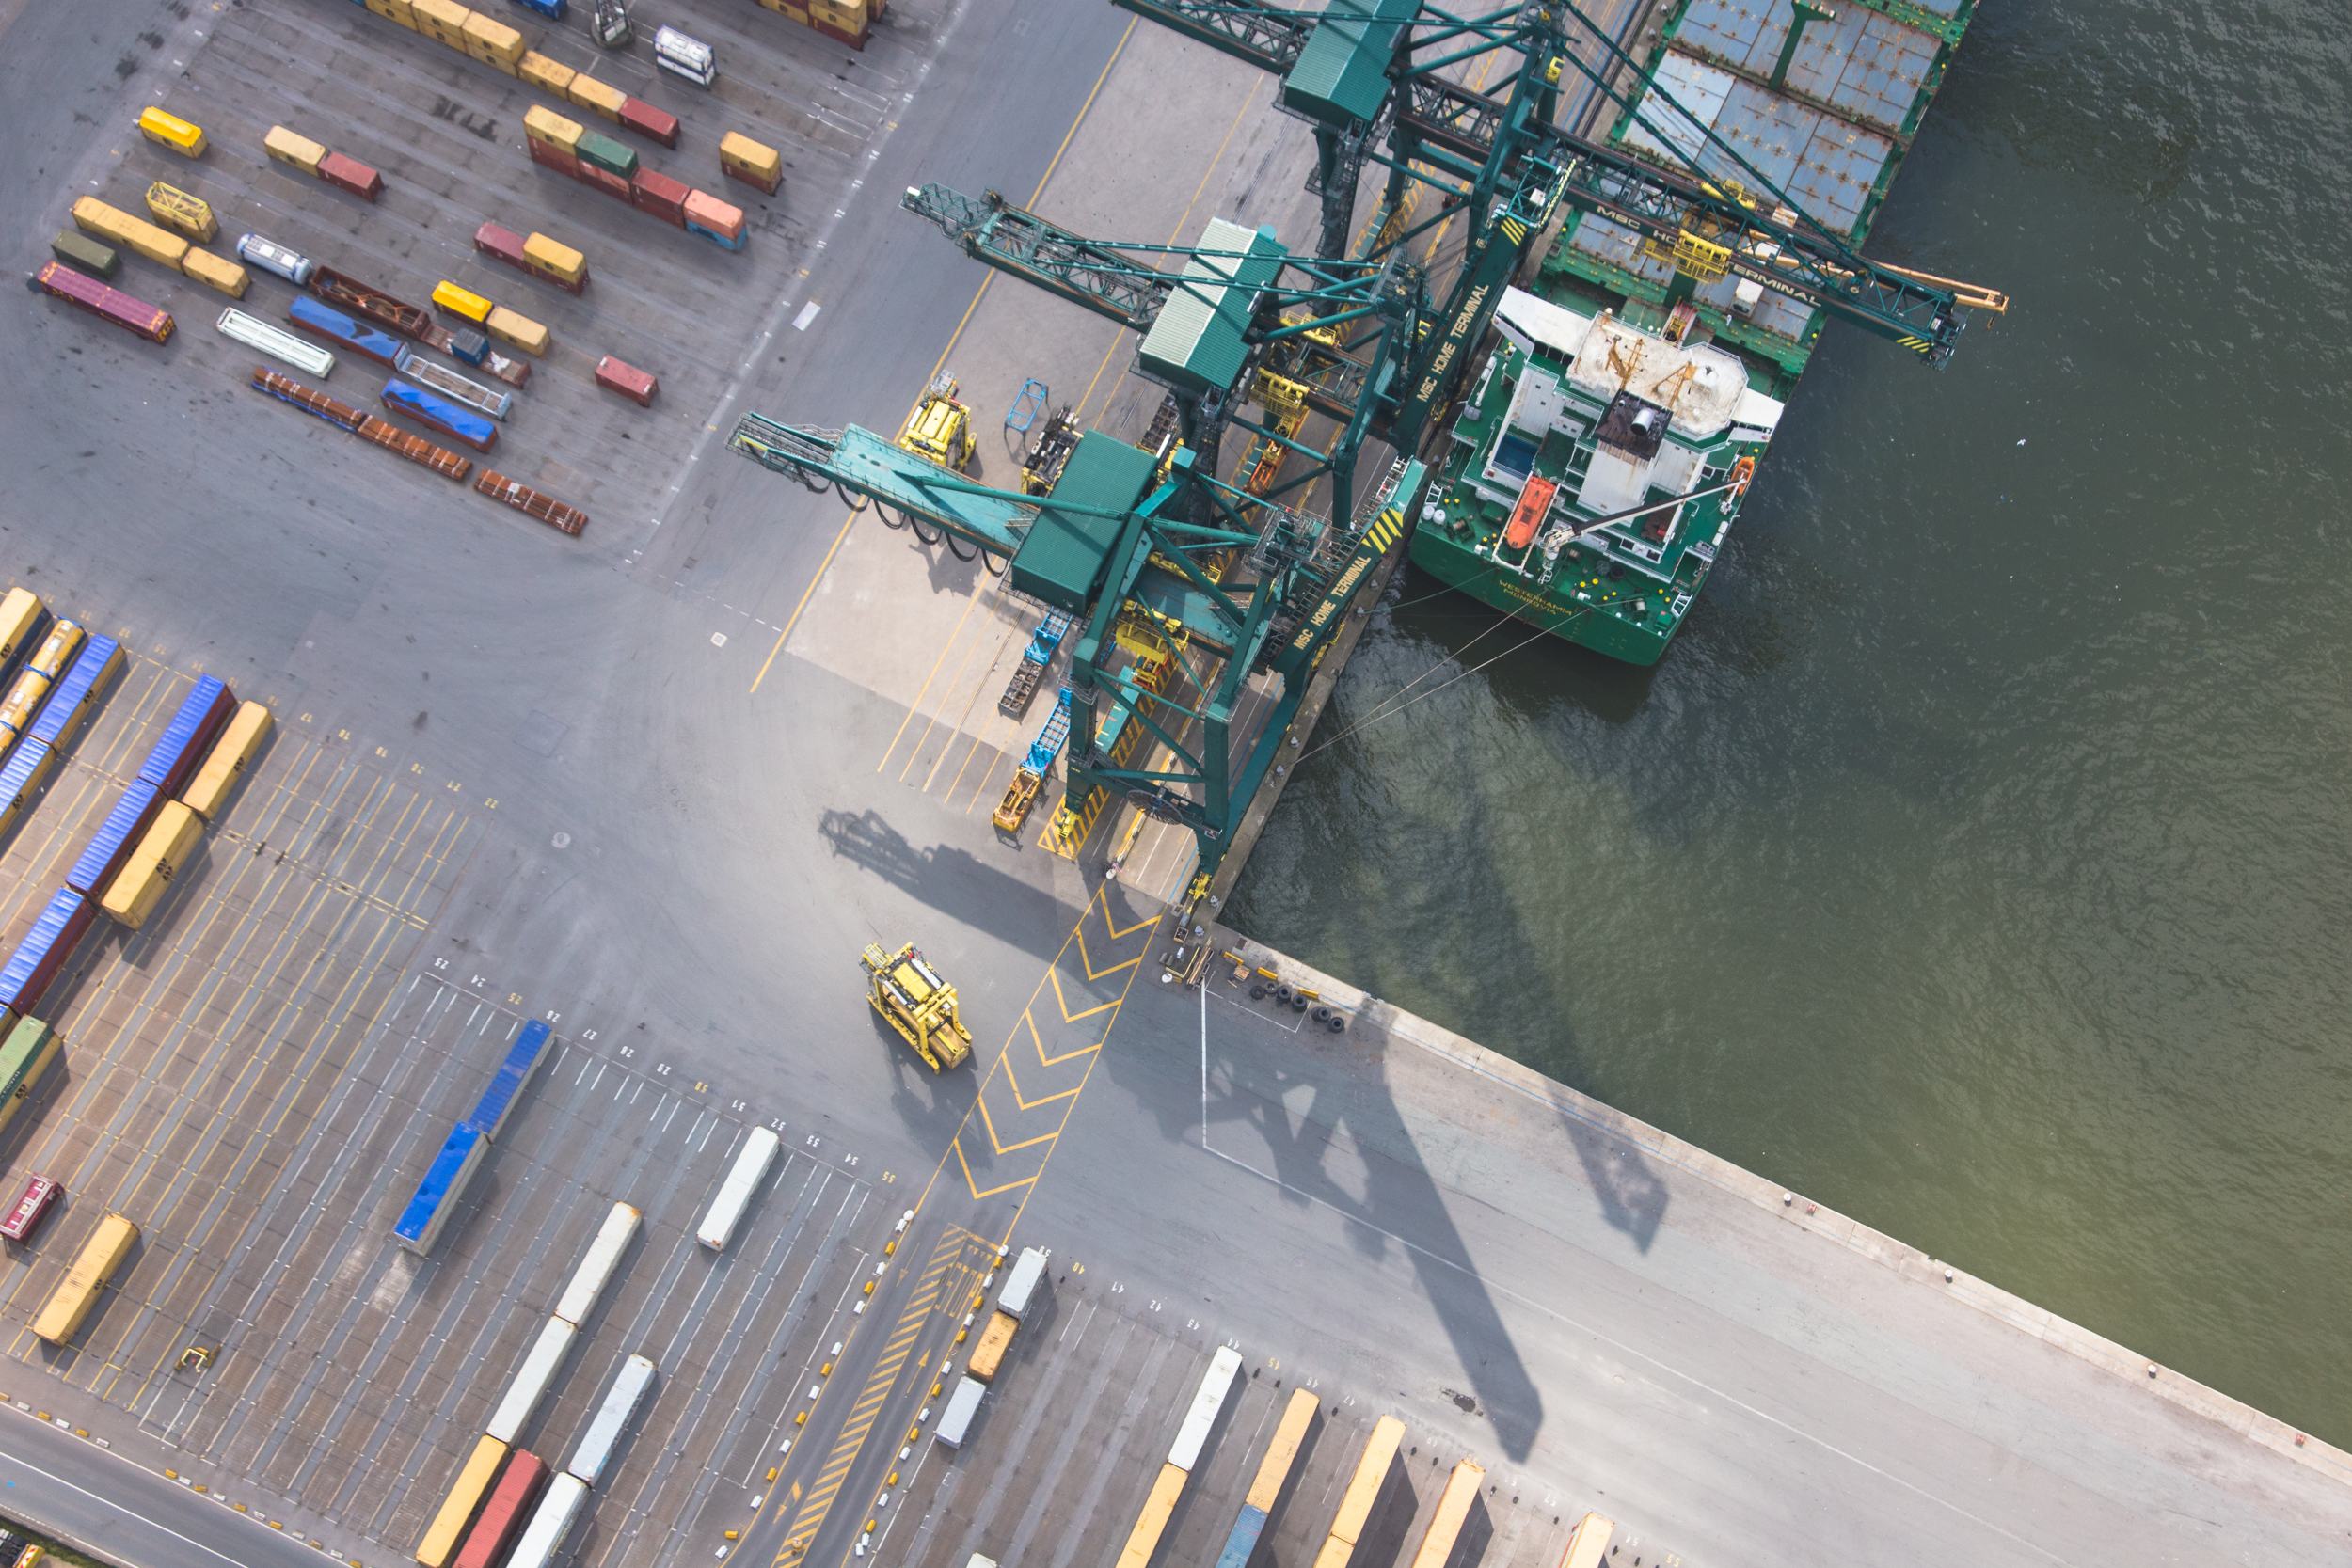
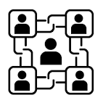
Blockchain:
the new kid on the block?
A verifiable trust machine!

Slide 24
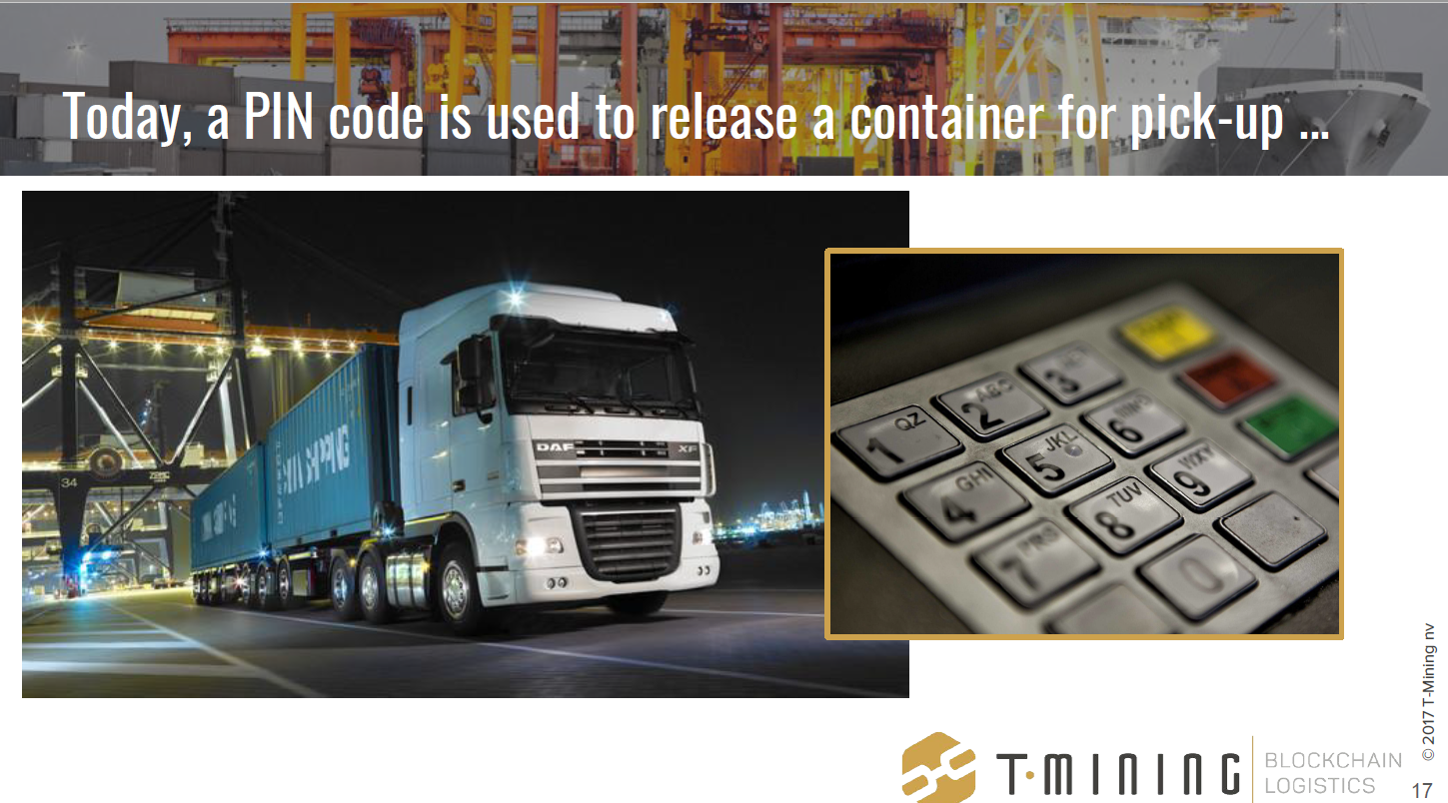

Slide 25

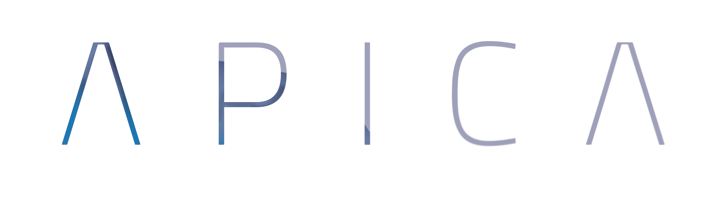
APICA:
Antwerp Port Information
& Control Assistant

Slide 26
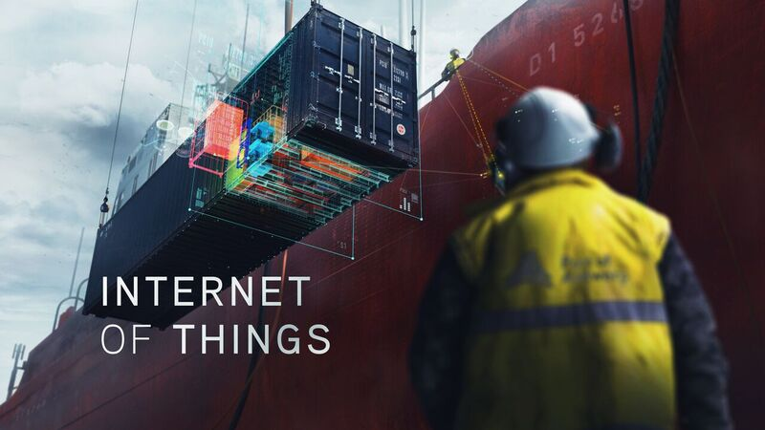


Slide 27
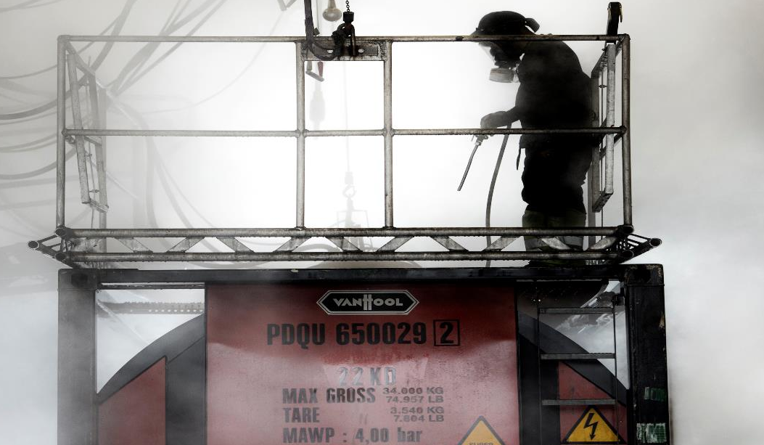
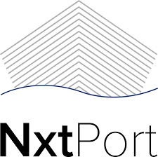
Connect Collaborate Innovate
e-European Cleaning Document
NxtPort as data custodian

Slide 28
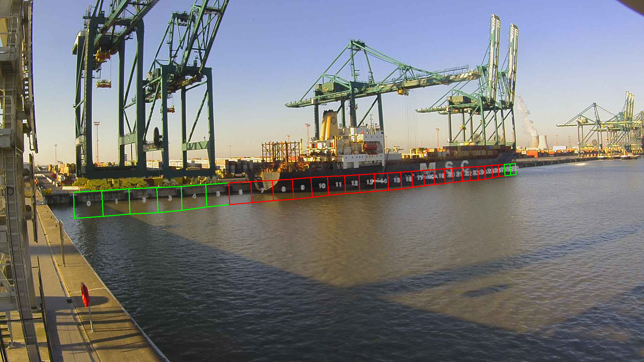
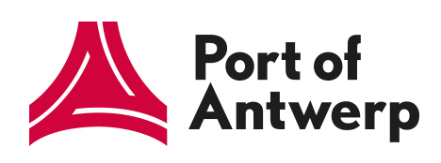
Smart Quay

Slide 29
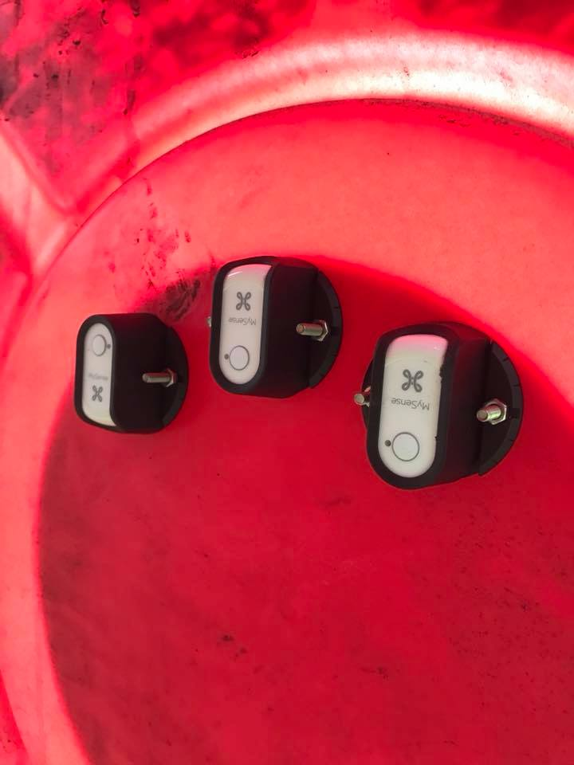
Smart buoys

Slide 30
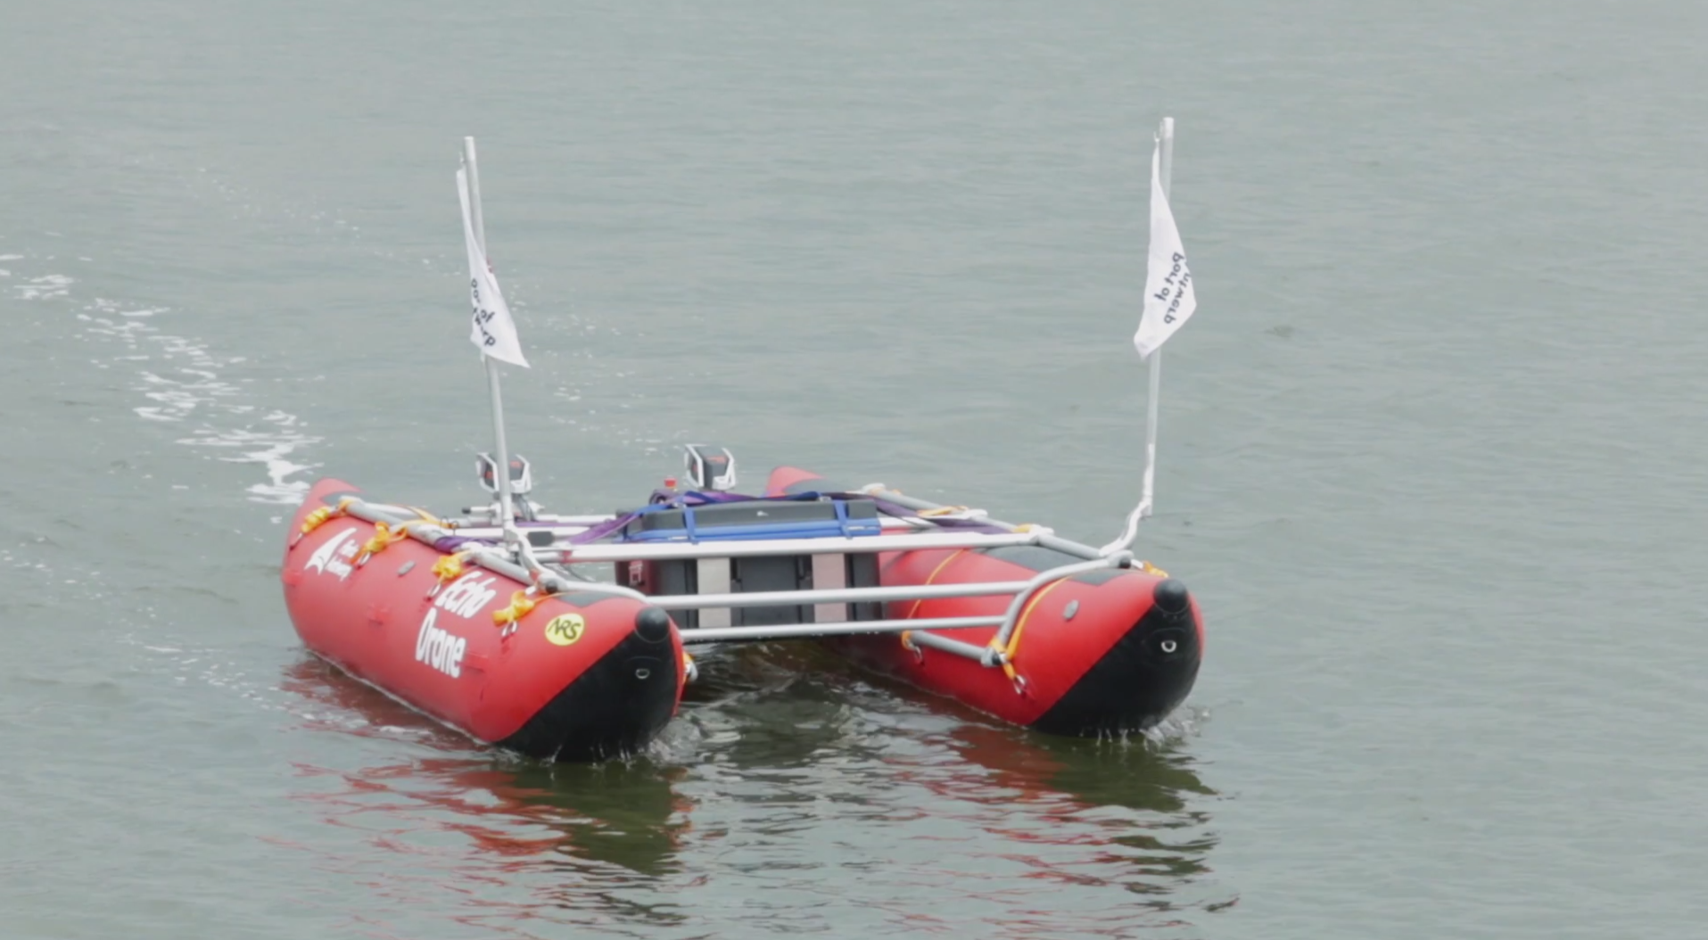
Echodrone

Slide 31

Augmented
reality app

Slide 32
