Slide 1
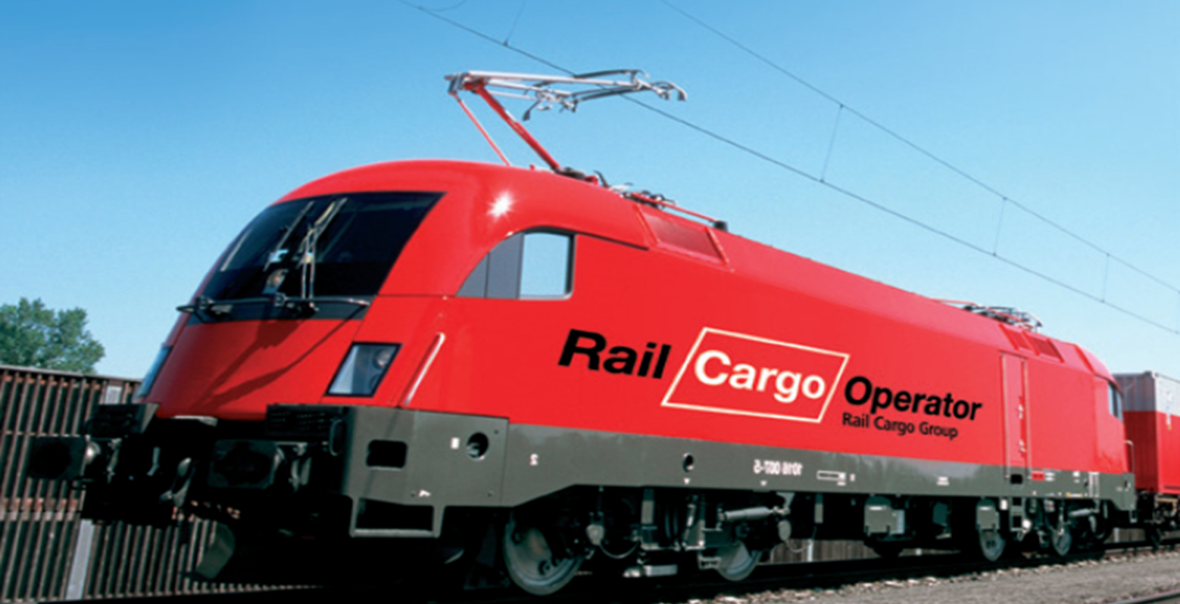
Rail Cargo Operator – CSKD
Bratislava terminal

Slide 2
RCO-CSKD major issues
RCO – CSKD major businesses:
Maritime open products from Hamburg/Bremerhaven to Czech and some Slovak destinations
Maritime company trains from Koper to Bratislava, Zilina but also Paskov
Continental from Zilina to Kaliningrad

Slide 3
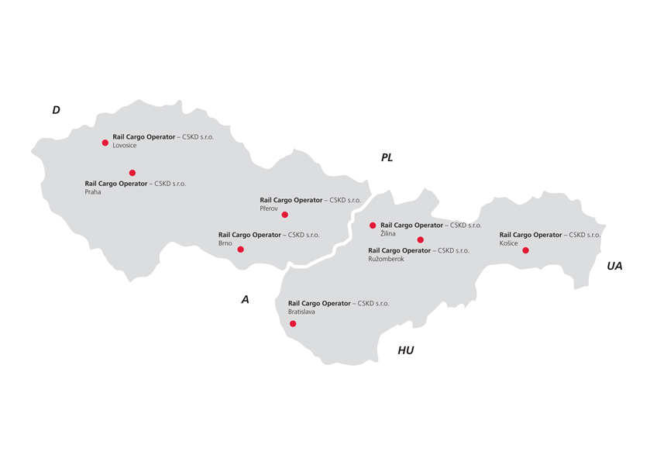
Terminal Bratislava
Has important strategic position for operating
in the areas as Austria and Hungary
Offers connection to container transports on Danube
Direct connection with Southern ports, particularly with the port Koper in Slovenia
Performs key role for our regular trains and transport solutions tailored for the needs of our customers in Slovakia, Hungary, Slovenia and Austria
Modern technical facilities
Experienced team opened to new challenges

Slide 4
Terminal Bratislava basic informations
Terminal area: 45 442 m2
Storage area: 21 953 m2
Storage capacity: 3 100 TEU
Railtracks: 1 x 350 m, 1 x 335 m
Reachstackers and forklift: 2 x Hyster 46t 1 x Hyster 9 t
1 x Nissan 4,7 t
Regular shunting: daily 5:00, 7:00, 9:00, 11:00,13:00, 15:00, 17:00, 19:00
Wednesday 21:00
Openning hours: Mon - Fri 5:00 – 19:00
Sat - Sun 7:00 – 19:00

Slide 5
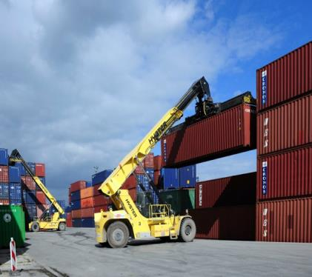
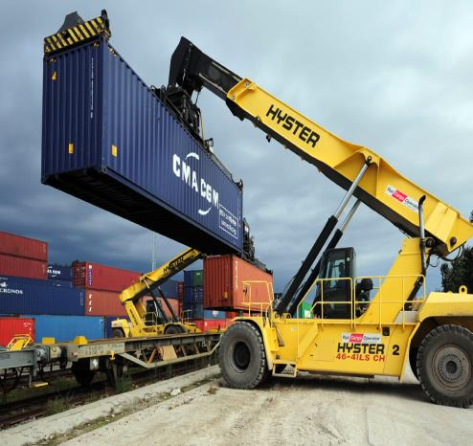
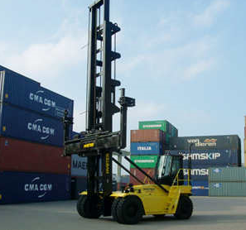
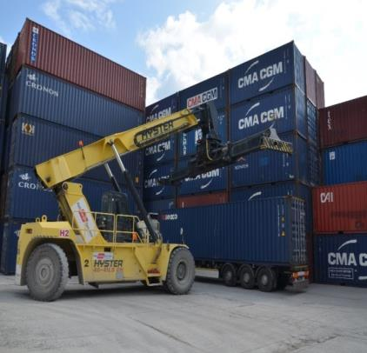
Our reach stackers

Slide 6
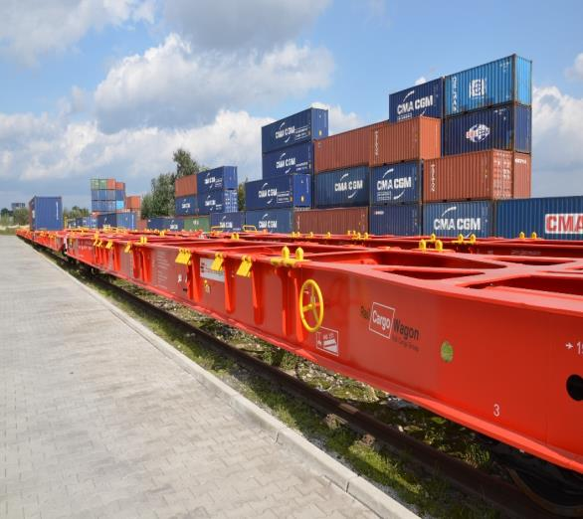
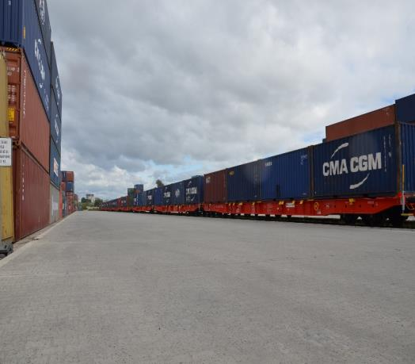
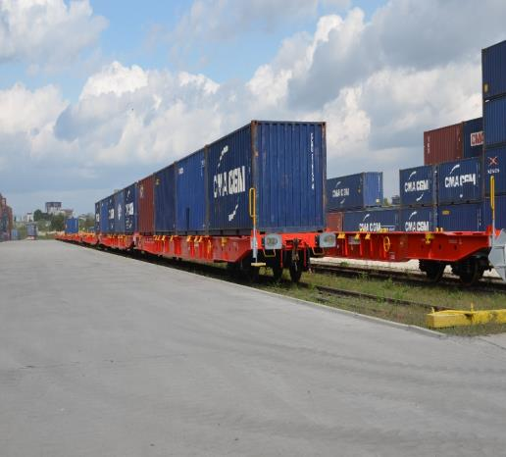
Modern wagon fleet

Slide 7
Manipulations in Bratislava
 | Manipulations | % Increase
Year 2011 | 25502 | -
Year 2012 | 26330 | 3%
Year 2013 | 35563 | 26%
Year 2014 | 53234 | 33%

Slide 8
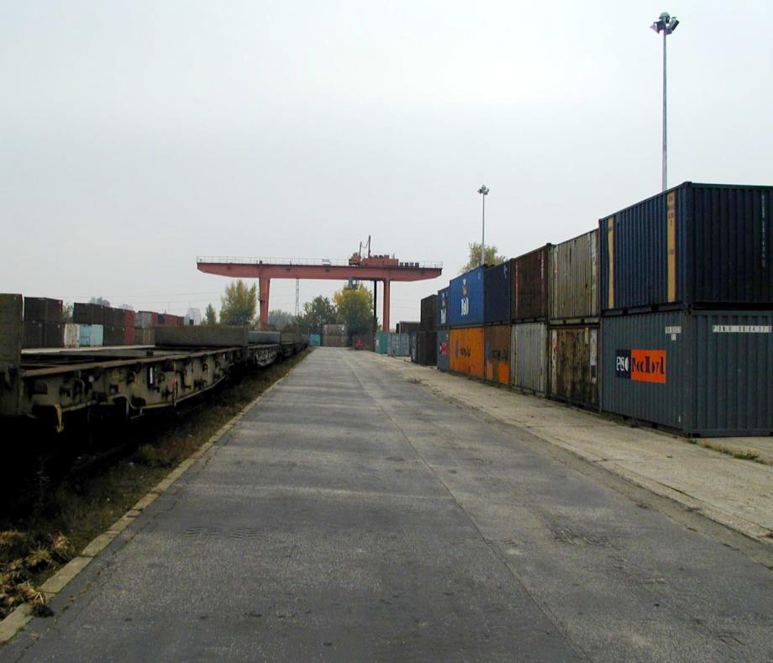
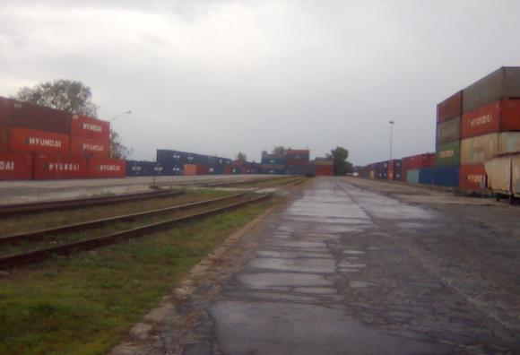
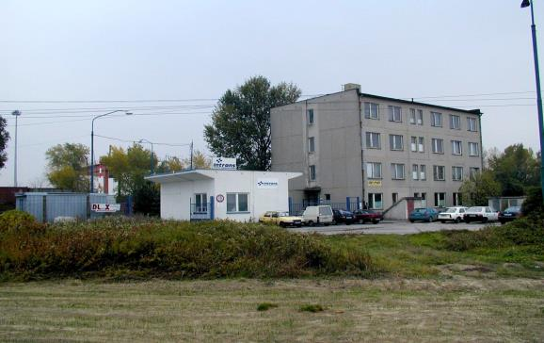
How we changed (2006 – 2010)

Slide 9
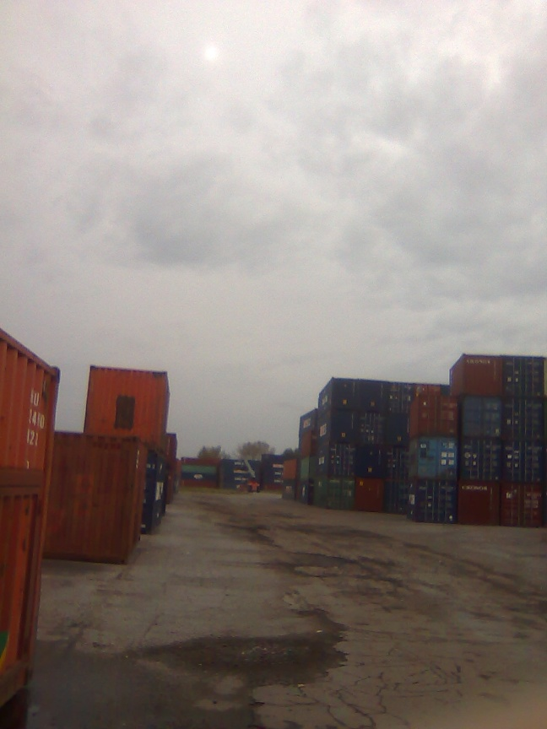
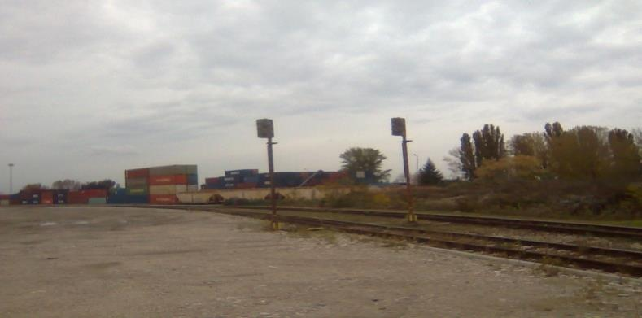
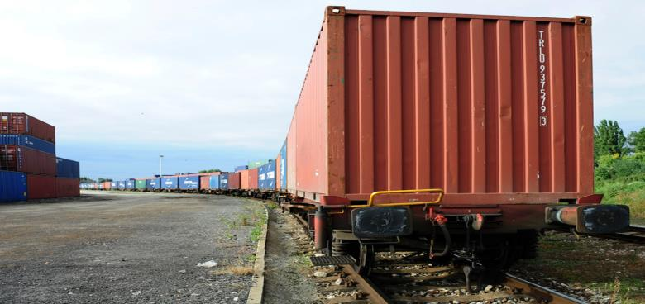
How we changed (2006 – 2010)

Slide 10
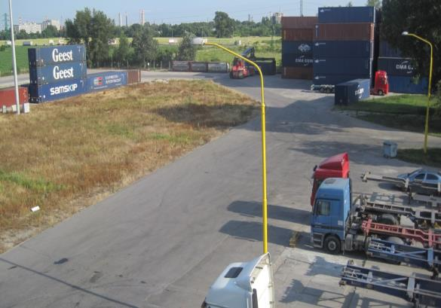
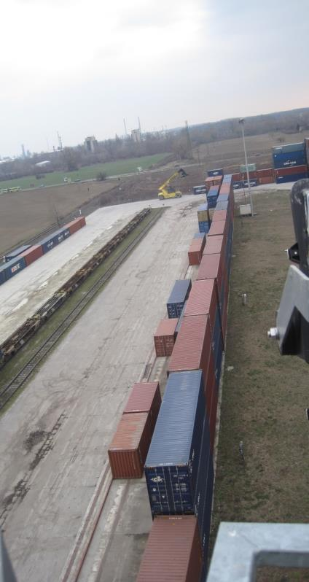
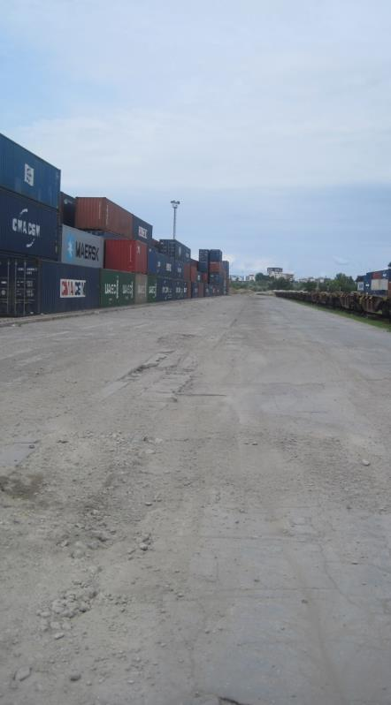
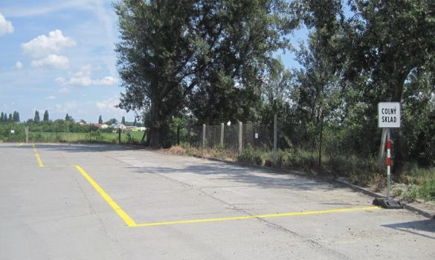
How we changed (2008 – 2011)

Slide 11
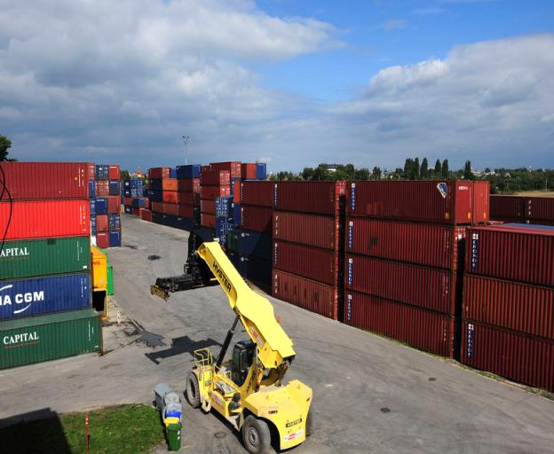
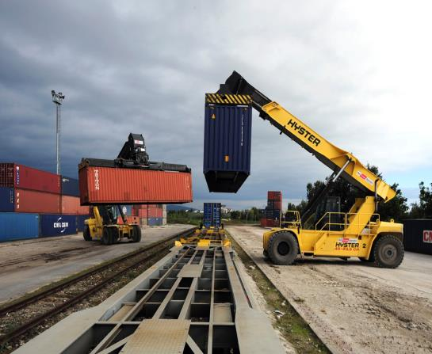
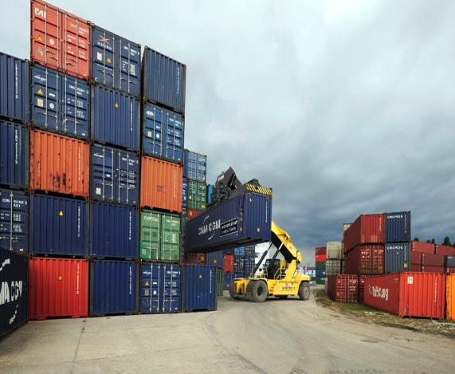
How we changed (2012 – 2013)

Slide 12
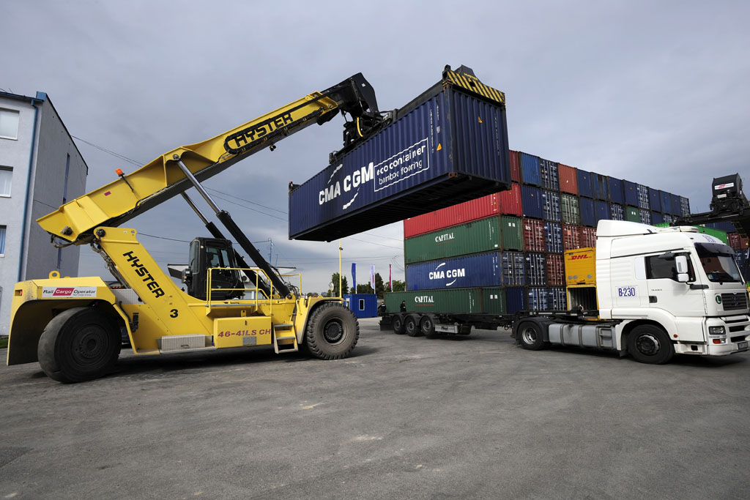
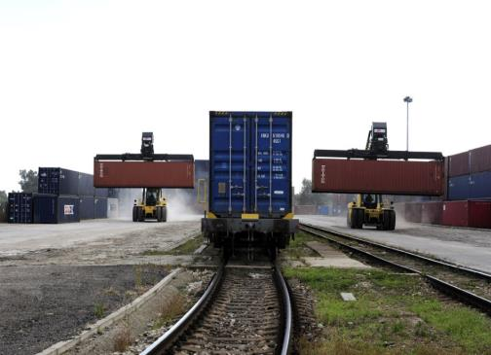
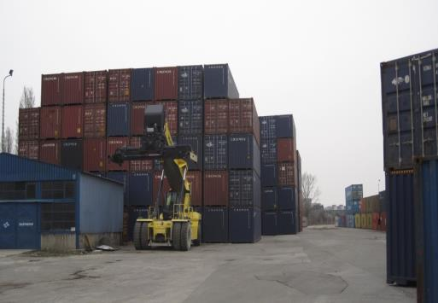
How we changed ( 2013 )

Slide 13
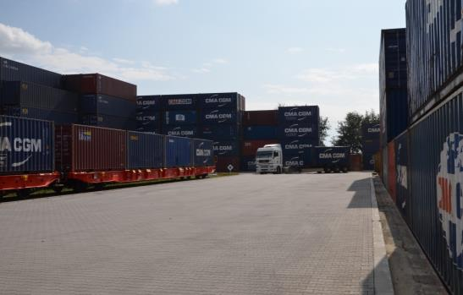
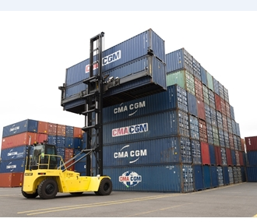
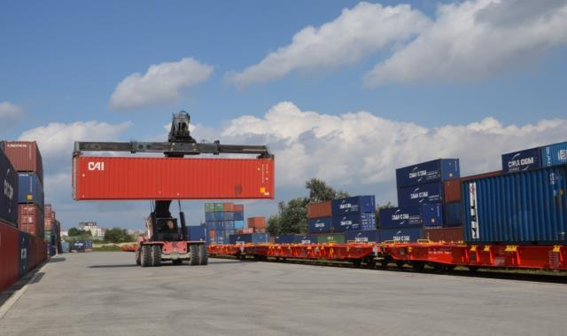
How we changed in 2014
New ground
New Hyster– able to load two empy containers at once
New wagons

Slide 14
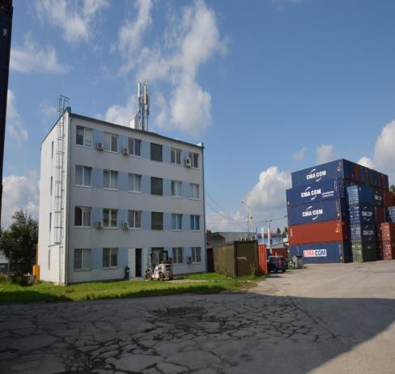
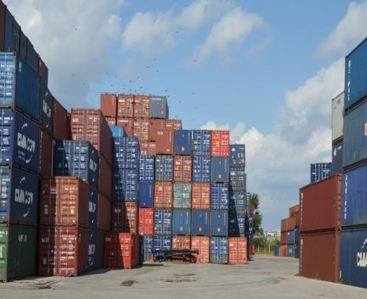
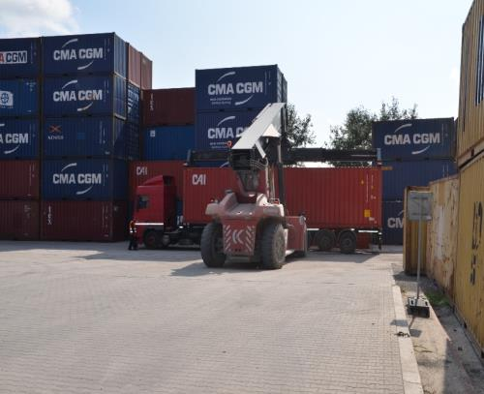
How we changed in 2014
New office building
Overloaded storage capacity

Slide 15
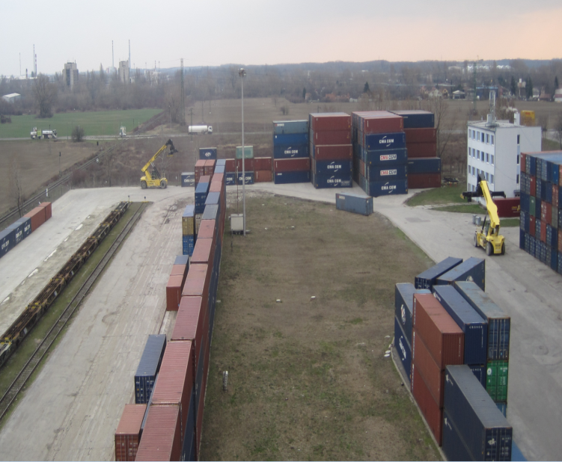
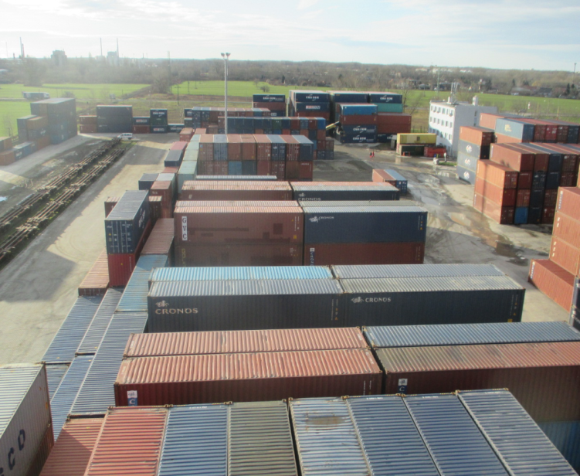
Comparison of the terminal in 2013 and 2015

Slide 16
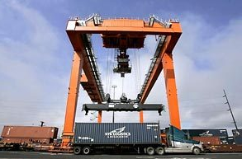
Future Investment
Automated system for yard managment
New storage area
Increasing of storage capacity
Simple evidence of the containers at the terminal
Many information at one click
Precise statistics
Most modern technic
Excellent service quality
Satisfied customers

Slide 17
Automated system for yard managment
Main advantages of system:
Quick installation
Maximal possible automatisation
Low installation and operative costs
Implementation GPS system - August of 2015

Slide 18
Automated system for yard managment
Container record-keeping on the yard
Monitoring of container manipulation on the yard
Automated identification of containers on manipulation
Searching for containers within the yard
Navigation to desired container
Possiblity of manual correction of the system in case when the full automation
is impossible
System administration
Navigation to desired container

Slide 19
Automated system for yard managment
Camera for ID recognition
Detection system for title of arm
ID of container
GNSS receiver GPS/GLONASS
Central control unit
Reachstacker
Block of containers
User terminal

Slide 20
RTG Case
In Bratislava we would work with 1RTG 1 reach stacker and 1 empty handler. The alternative is 2 reach stackers and 1 empty handler
The RTG has higher lease costs but much lower operating costs, including fuel
The RTG solution would lead already in first years to similar costs as reach stacker with around 60.000 manipulations annually (2014 was already 53.000)
Additional savings would come at later years as reach stackers would be needed replaced at later time

Slide 21
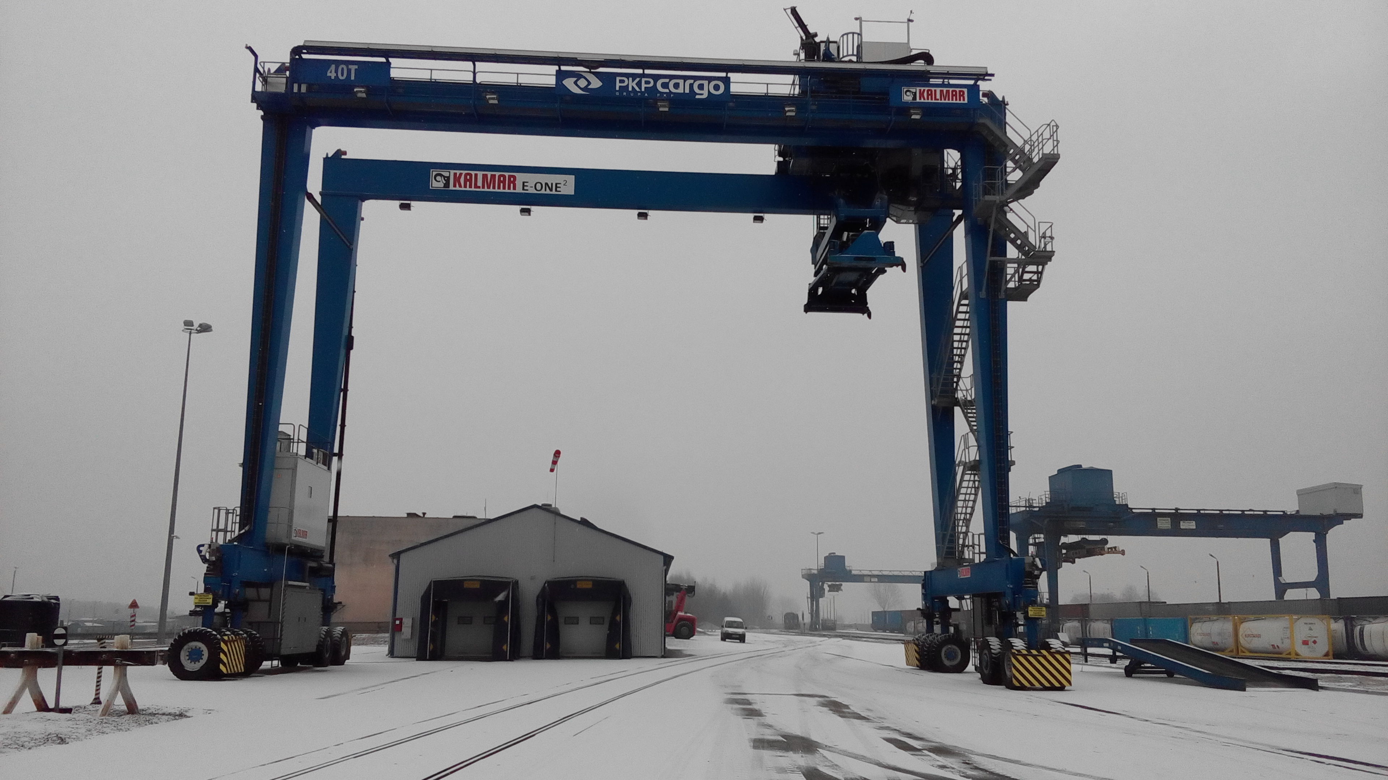
RTG crane
Implementation RTG crane – January of 2017
Picture for illustrated

Slide 22
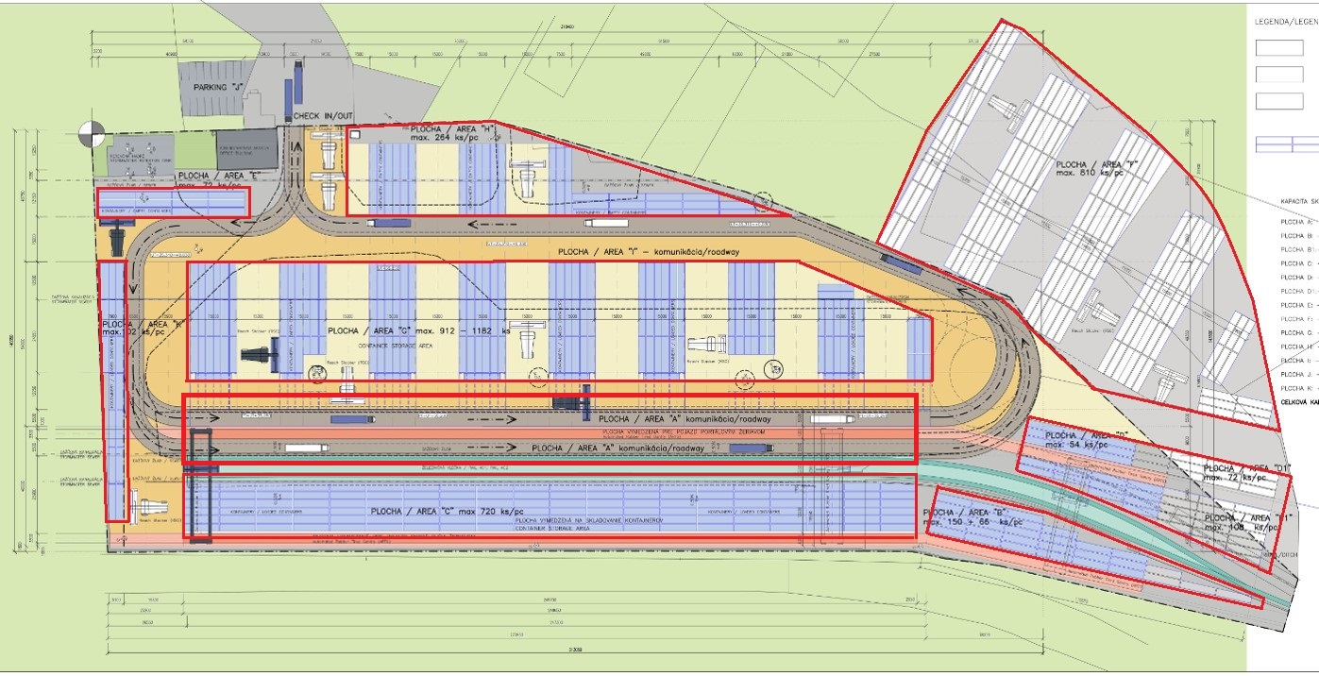
Future investment
AREA „H“
AREA „E“
AREA „F“
AREA „G“
AREA „K“
AREA „A“
AREA „D“
AREA „C“
AREA „B“

Slide 23
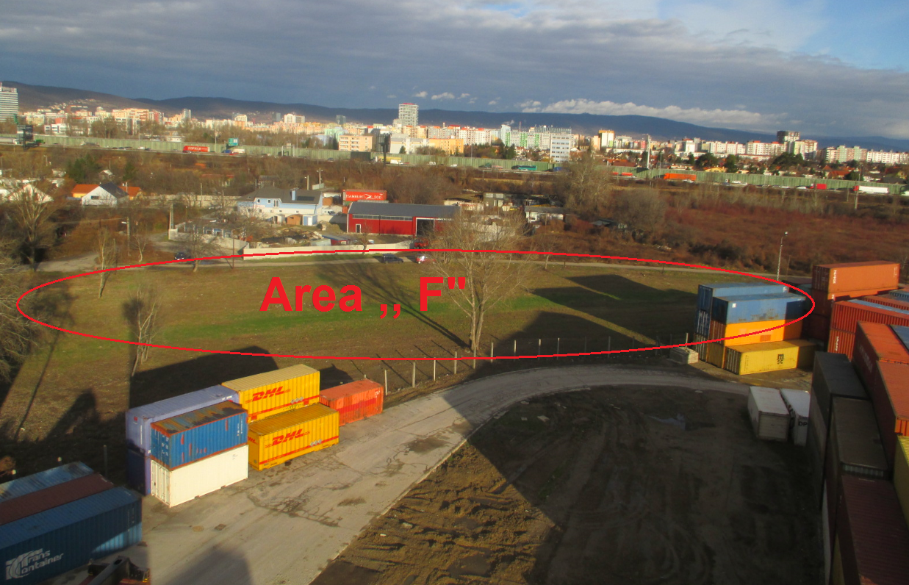
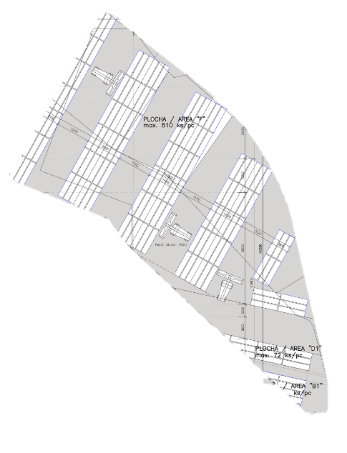
Future investment
New storage area ,,F“ with total capacity 12000m2

Slide 24
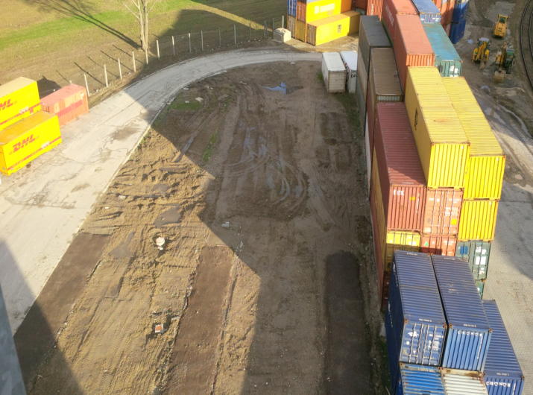
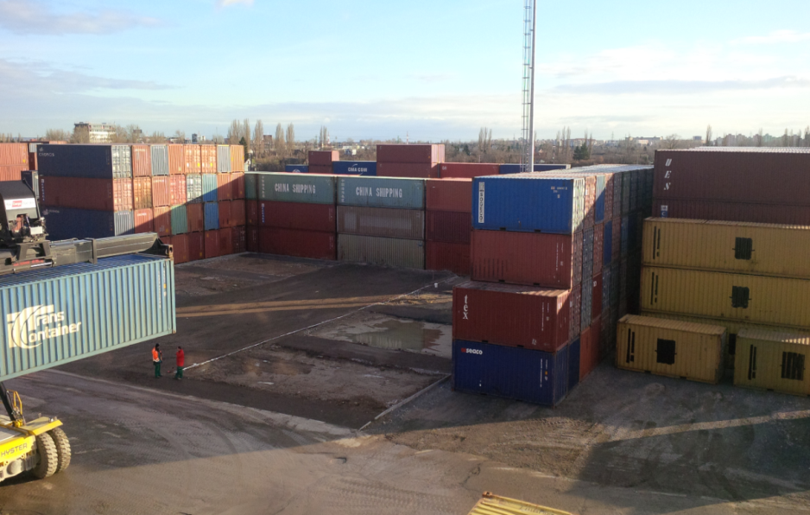
Future investment
New area
Increase of storage capacity

Slide 25
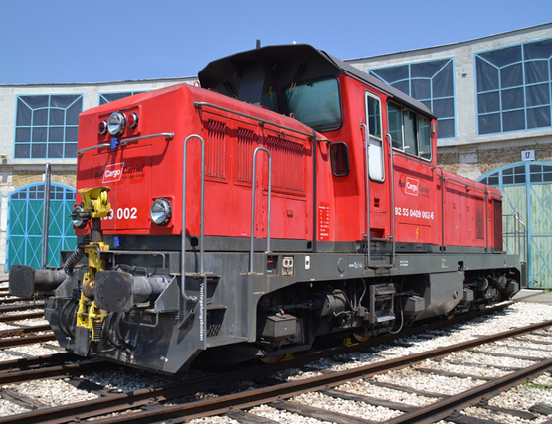
Future plans
To start using own locomotive with help of Rail Cargo Carrier
Faster transit time
Better service
Money savings

Slide 26
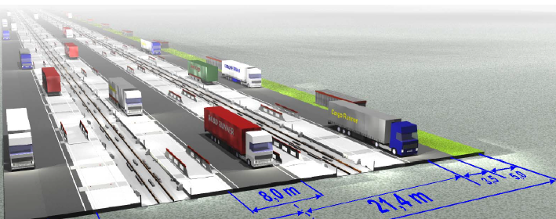
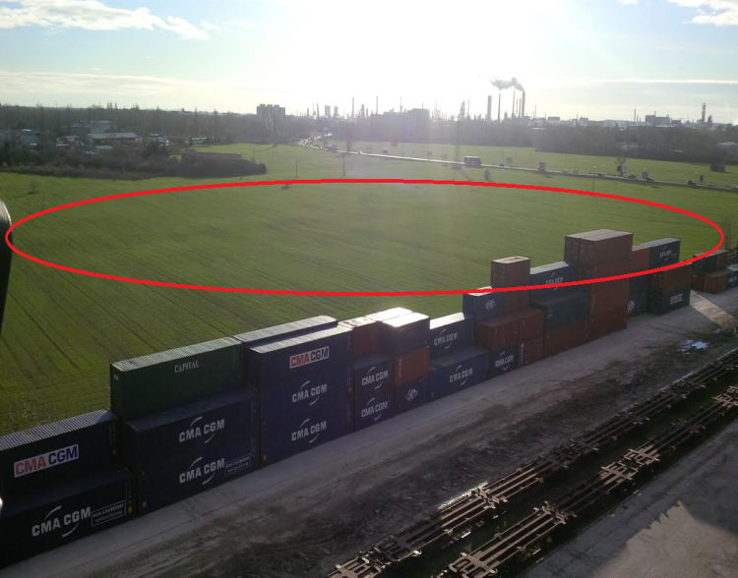
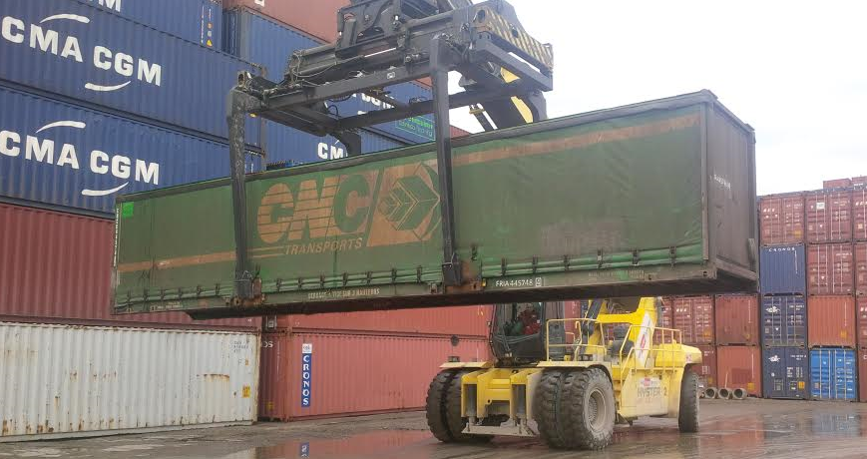
Future potentional
Increase storage area for new project of CargoBeamer and Volkswagen Slovakia
Sustainable & ecological semi-trailer transport on rail

Slide 27
Thank you for your attention

